Slide 1
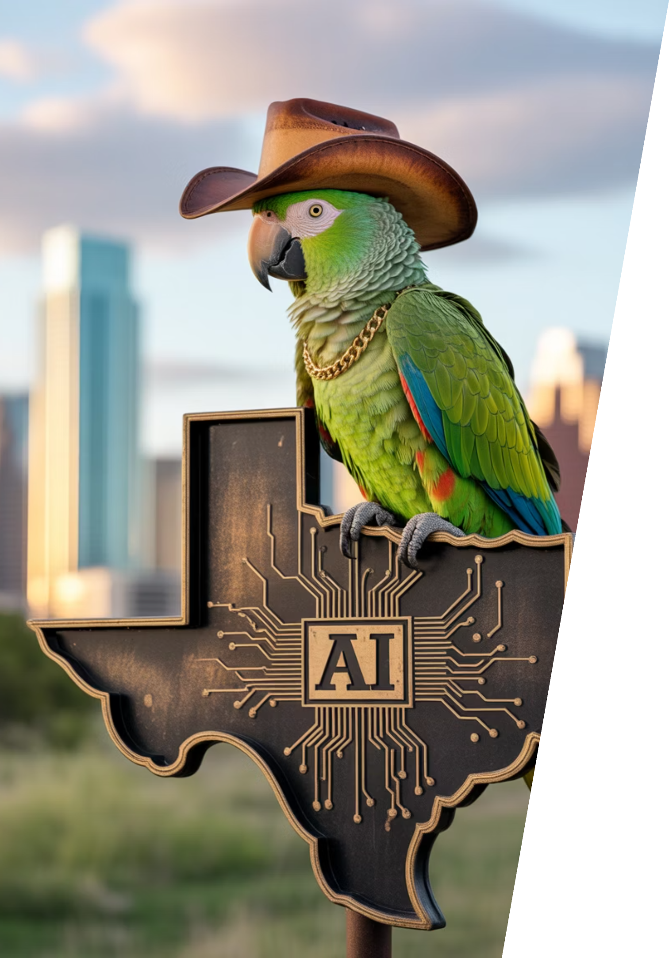
Austin LangChain AIMUG
Welcome to the Austin LangChain AIMUG - where Texas innovation meets AI exploration! Join our community of tech enthusiasts, developers, and AI practitioners as we learn together in an open, supportive environment.

Slide 2
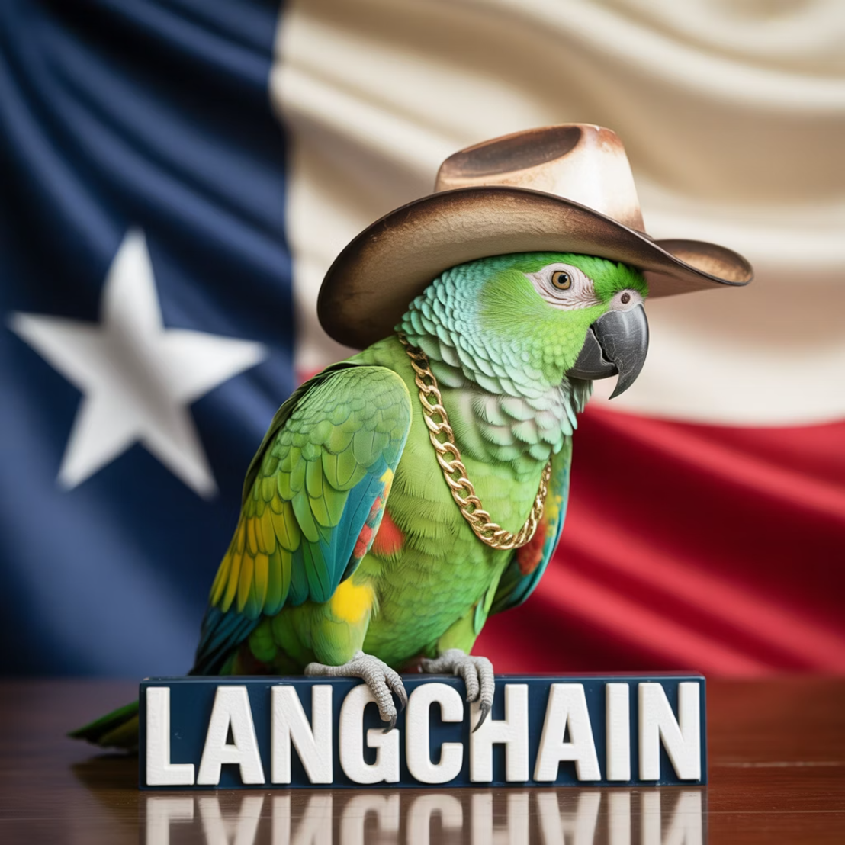
Today's Agenda
1
Intros
Get to know your fellow AI enthusiasts
2
LangChain / LangGraph 1.0 Alpha Update
Colin shares insights from Harrison's team on directions and naming steps
3
Talks & Demos
Sal on Claude Code & custom agents,
Collier on deep agents,
James demos 'Rosie the Robot'
4
Wrap Up & After Party
Continue the conversation upstairs at The Tavern
Interviews thanks to James
Start Time: 6:20 PM
Notes:
James will be conducting podcast interviews at The Tavern after the meeting as part of the wrap-up activities.

Slide 3
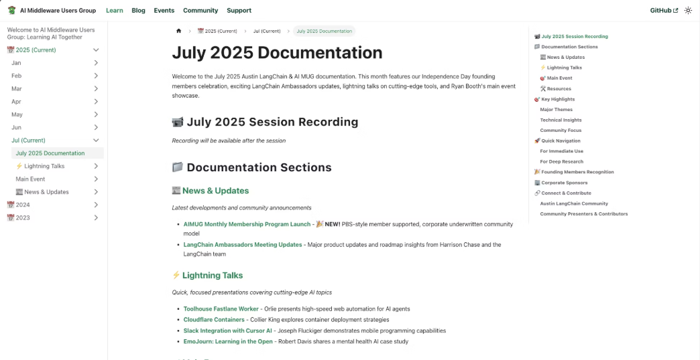

AIMUG.ORG – Docs
1
Visit AIMUG.org
Our digital home for all resources, events, and community updates
2
Explore Learn Section
Curated tutorials, guides, and educational materials for all skill levels
3
Check July 2025 Resources
Latest documentation, code samples, and community contributions
Our documentation is community-driven and constantly evolving, just like our Texas-sized ambitions for AI development.

Slide 4

AIMUG - Member Supported - Founding Members
Founding Members
Colin Best
Collier King
Cameron Rohn
Joseph Fluckiger
Karim Lalani
Jeff Linwood
Orlando Kalossakas
Riccardo Pirruccio
Robert (Muzz)
Scott Askinosie
Zack Angelo
Ryan Booth
Colin McNamara
Hutch Enbach
Christopher Ewing
Kaiwalya Joshi
Miguel Lucero
John Van Lowe
R Sarasa
Roberto Fuentes
Nate Little
Wendy Schorn
Sal Castoro
Our community thrives thanks to the passion and dedication of our founding members who share a vision for democratizing AI knowledge in the heart of Texas:

Slide 5

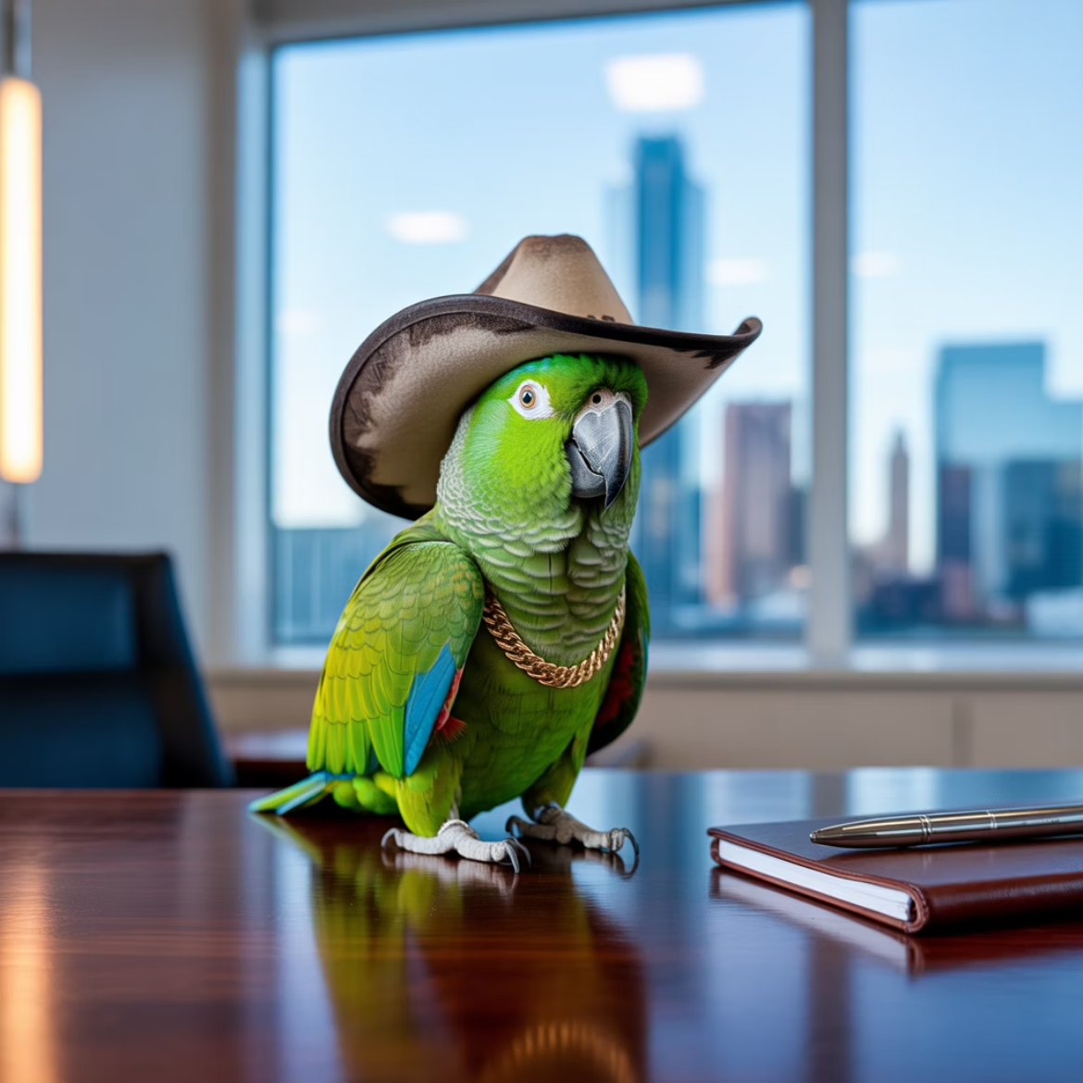

Corporate Underwriters
Our initiatives are made possible through the generous support of organizations that believe in the power of community-driven AI education and innovation:
Center for Government and Civil Services
LangChain AI
Providing technical resources and framework support
Supporting public sector AI applications and education
Always Cool Brands / AI
Championing ethical AI development across industries

Slide 6







HI, I'm Colin McNamara
Entrepreneur
Co-founder of Always Cool Brands | AI Using AI to take Poison out of our Food Supply (LangChain / LangGraph User)
Community Builder
Founding Member of Austin LangChain AIMUG, committed to growing our Texas AI ecosystem
50% Developer
Consulting Engineer, Cloud Builder, Casual Coder with a passion for practical AI solutions
Public Good: Helping our community succeed by bringing Texas hospitality to the AI world
Connect with me on LinkedIn

Slide 7

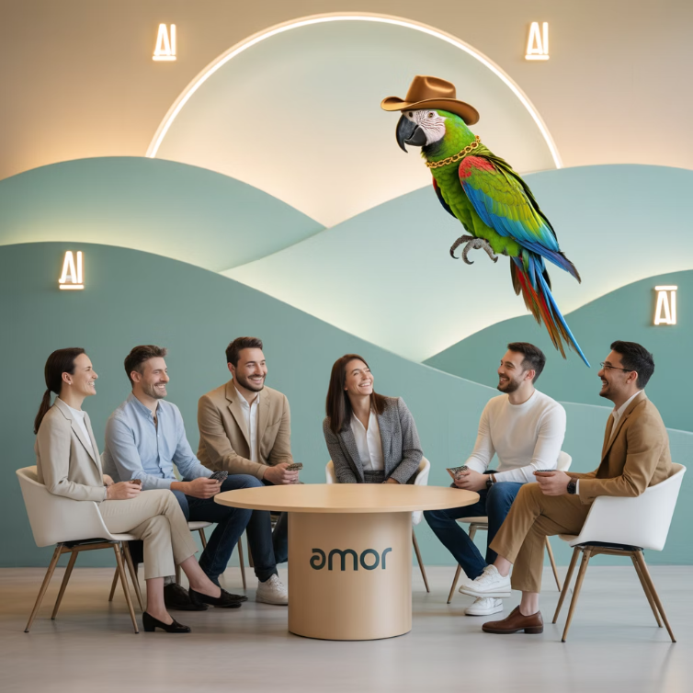
Who We Are
1400+
100%
24/7
Members Strong
Learning in the Open
Supportive Community
Connecting Austin's tech, creative, and business leaders passionate about AI, bringing together Texas innovation with cutting-edge technology
Exploring AI through the lens of LangChain, pulling the ecosystem together with Texas-sized ambition and collaborative spirit
A well-balanced Discord that's "useful, but not overwhelming" - reflecting our commitment to southern hospitality in the tech world

Slide 8
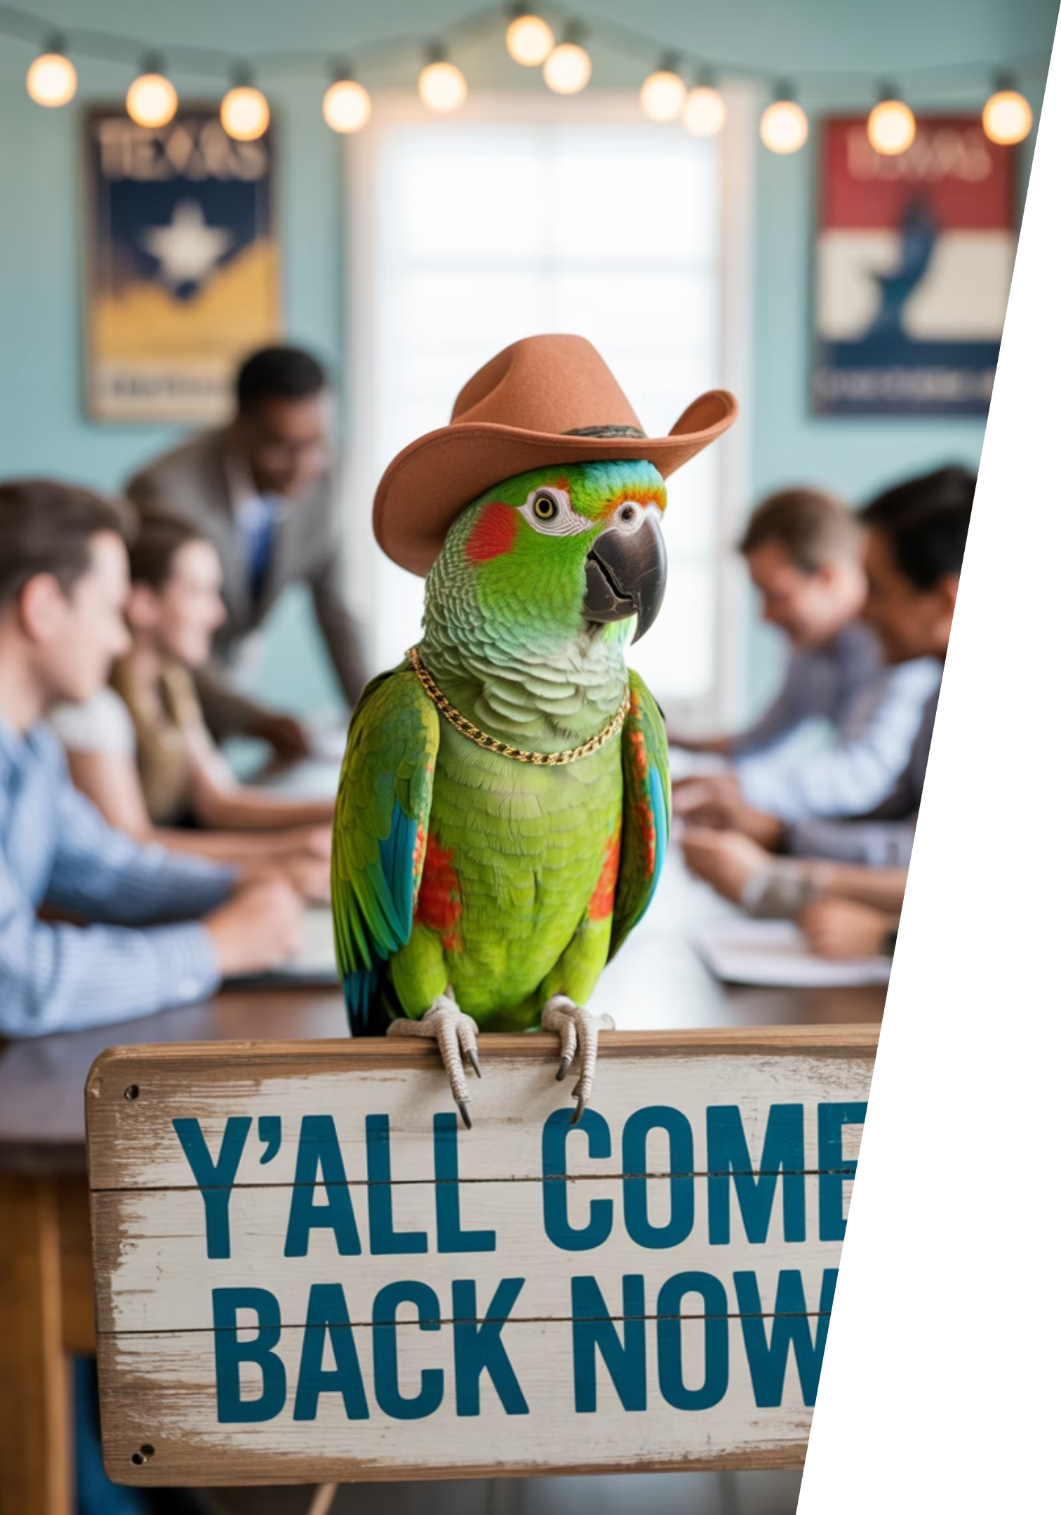




Learning in the Open – "Be Cool to Each Other" ✌️
Our community values reflect the best of Texas: friendliness, openness, and a genuine desire to help each other succeed.
Respect & Inclusivity
Our only rule is simple: "Be cool to each other, don't be gross." Texas hospitality meets tech community values.
AI Enthusiasts of All Levels Welcome
We celebrate diverse perspectives and unique paths in AI, whether you're a beginner or expert.

Slide 9
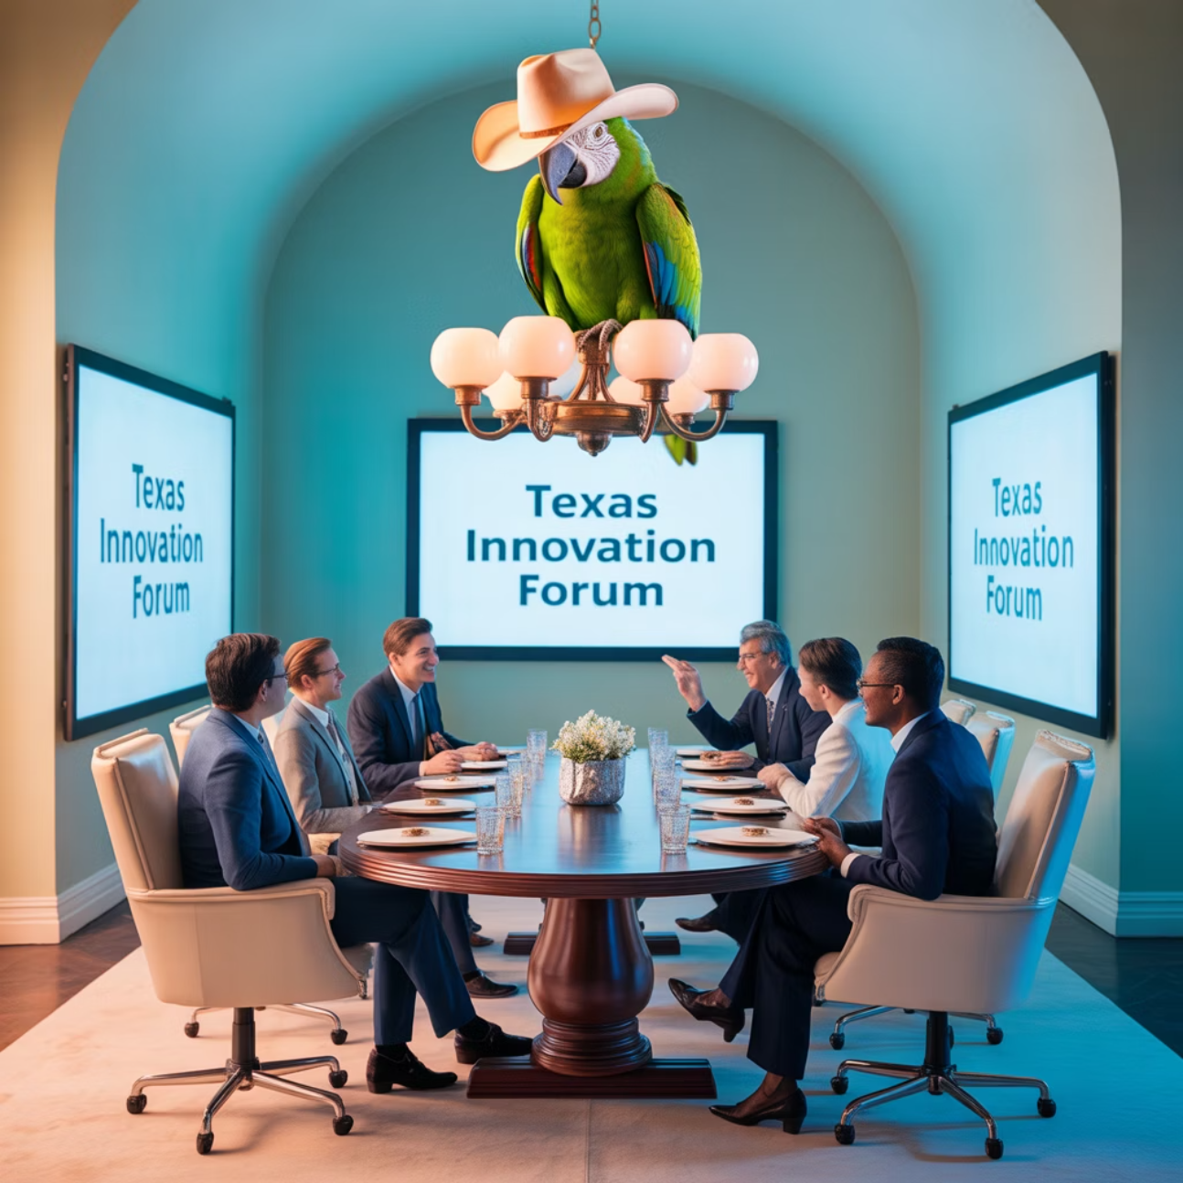
Where and When We Meet 🌟📅
Monthly Showcases, Labs & Mixer
1
Location: ACC RGC3000
Community members and vendors share projects, demos, and hands-on learning opportunities in a collaborative Texas atmosphere
2
Hacky Hours (ad hoc)
Location: Rotating Local Bars
Informal happy hours at local spots; meet, discuss, and relax with fellow AI enthusiasts over Texas craft beers
Weekly Virtual Syncs
3
Online: Tuesdays at 5PM
Workshopping, problem-solving, and AI discussions from the comfort of your home or office

Slide 10
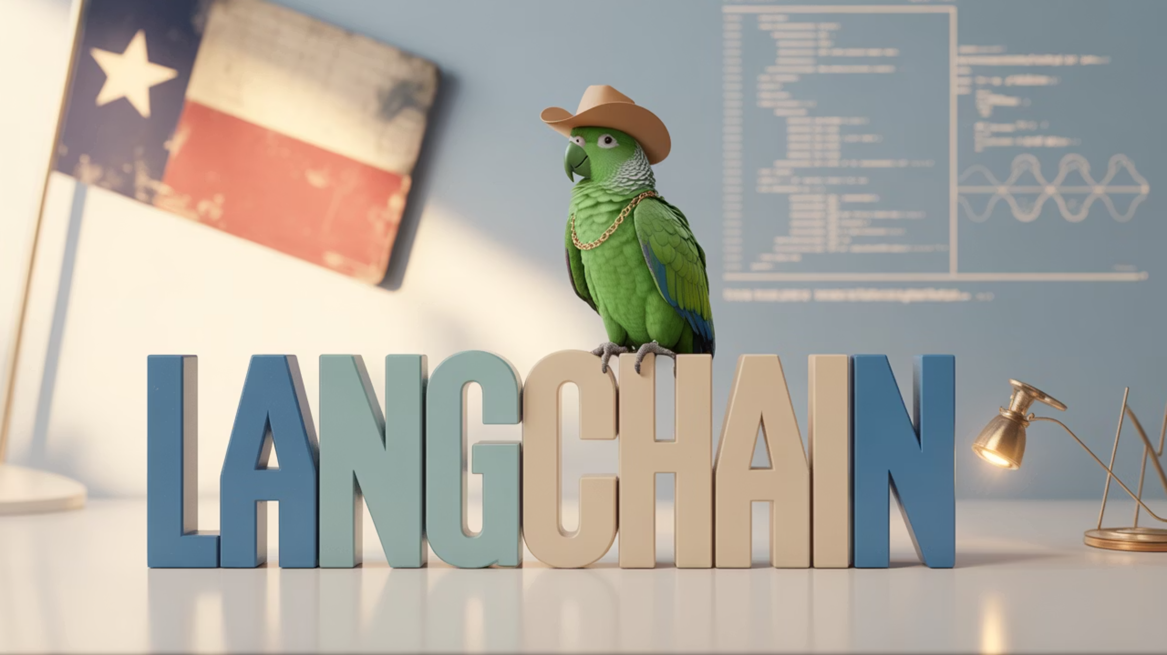
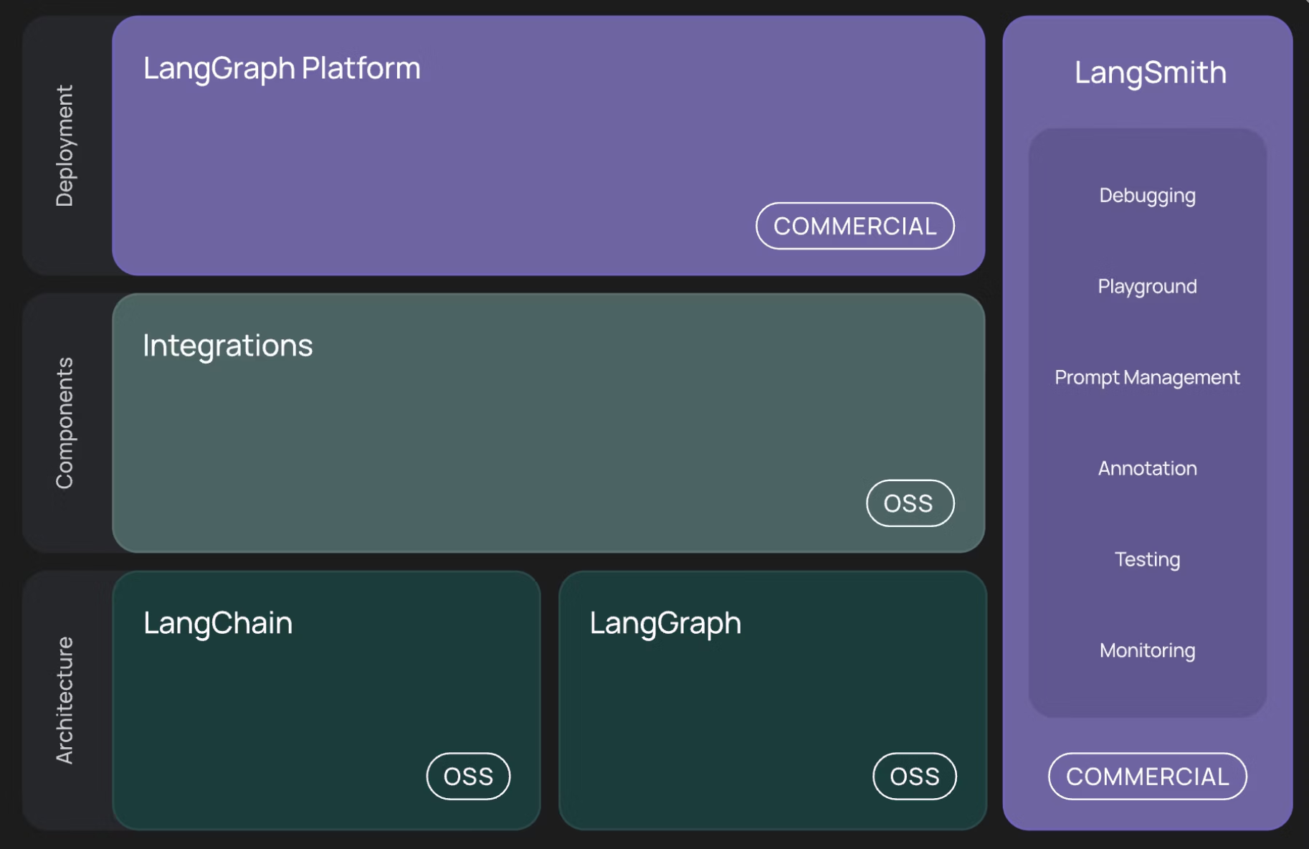
WTF is LangChain?
LangChain is a framework for developing applications powered by language models, enabling:
Context-Aware Applications
Connect LLMs to external data sources and systems
Reasoning Capabilities
Chain multiple LLM calls together for complex logic
Agent-Based Systems
Create autonomous AI assistants that interact with tools
Just like Texas prides itself on building connections, LangChain connects AI models to make them more powerful and practical.

Slide 11
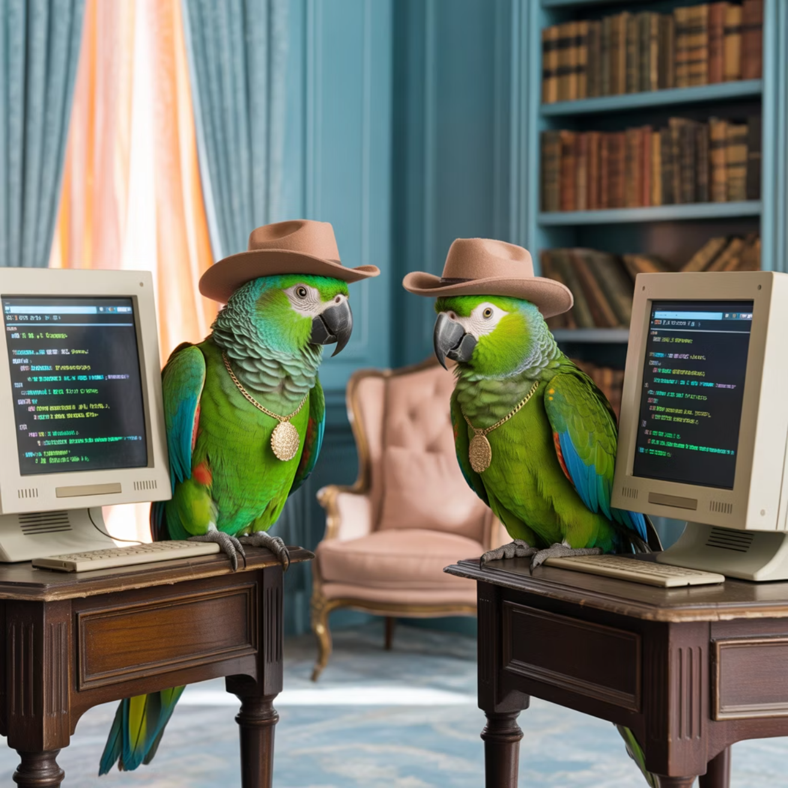
Talks & Demos!
LangChain/LangGraph Update - Colin
Insights into LangChain/LangGraph 1.0 Alpha, including discussions and updates from Harrison's team.
Cloud Code & Custom Agents - Sal
Dive into how Claude Code, custom agents, and subagents work together to build powerful AI applications.
Deep Agents - Collier
An in-depth presentation exploring the concepts and applications of deep agents.
"Rosie the Robot" Demo - James
A 15-minute live demonstration of a desktop cleanup project, incorporating mind chain topics and practical AI solutions.
Our mascots are ready for a variety of exciting lightning talks and demos!
”Streamlit Dashboard – Jeff Linwood
A quick overview of how to build dashboards in streamlit that incorporate LangChain

Slide 12

LangChain/LangGraph 1.0 Alpha Update
Colin McNamara
Colin shares the latest developments and strategic insights directly from Harrison's team at LangChain, shaping the future of LLM applications.

Slide 13
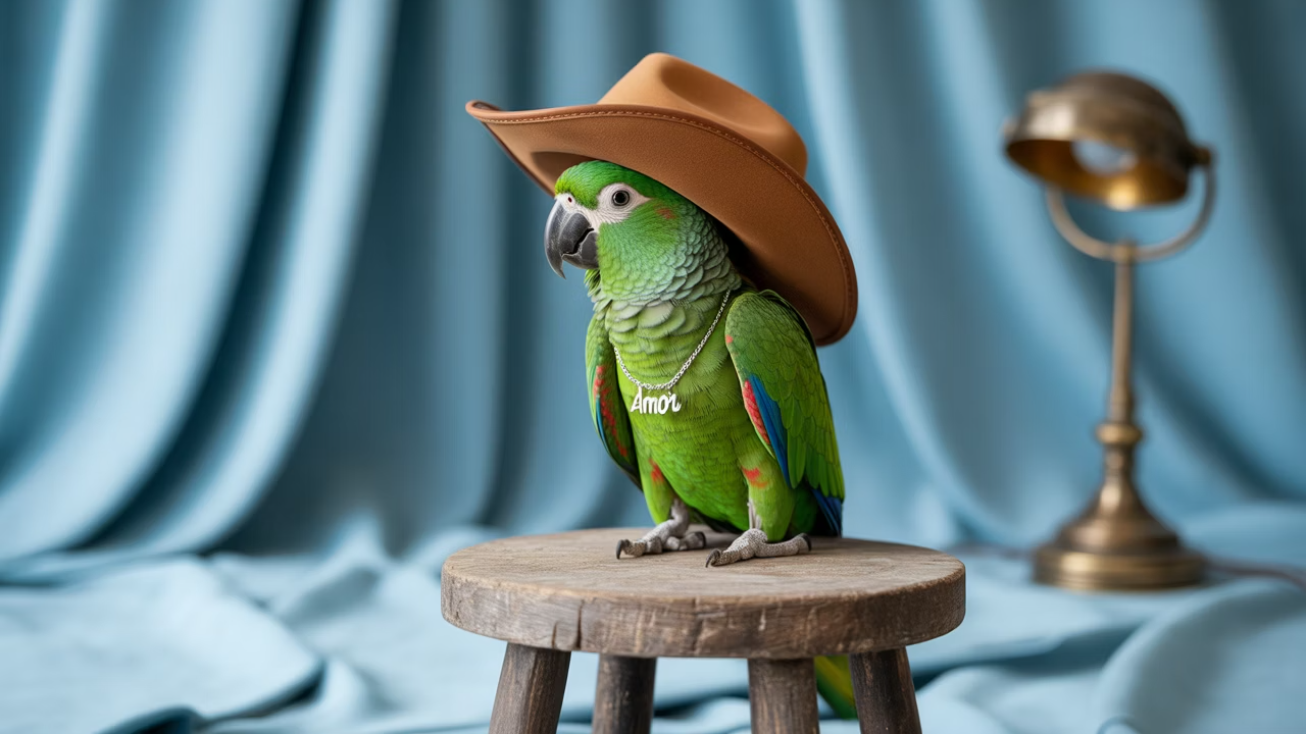
LangGraph 1.0α & LangChain 1.0α — the new defaults for building agentic systems
Alpha releases for LangGraph and LangChain in Python & JS are here, targeting late October for the official 1.0 release. This represents a fundamental shift toward shrinking surface area and hardening the runtime to ship faster with more reliability.
Alpha notice: docs and content are evolving rapidly. Treat this as try now, production-gate later while we finalize the 1.0 release.

Slide 14
The big picture in one slide
LangChain 1.0α
LangGraph 1.0α
A single, focused agent (create_agent / createAgent) built on LangGraph
Promoted with no breaking changes; durable execution, streaming, HITL, and time travel
LangChain-Core
Unified Docs
Introduces standard message content via .content_blocks / contentBlocks (typed, provider-agnostic, back-compatible)
Unified docs site across Python & JS for streamlined developer experience
This is the mental model shift: LangChain = entry + patterns; LangGraph = runtime & control.

Slide 15

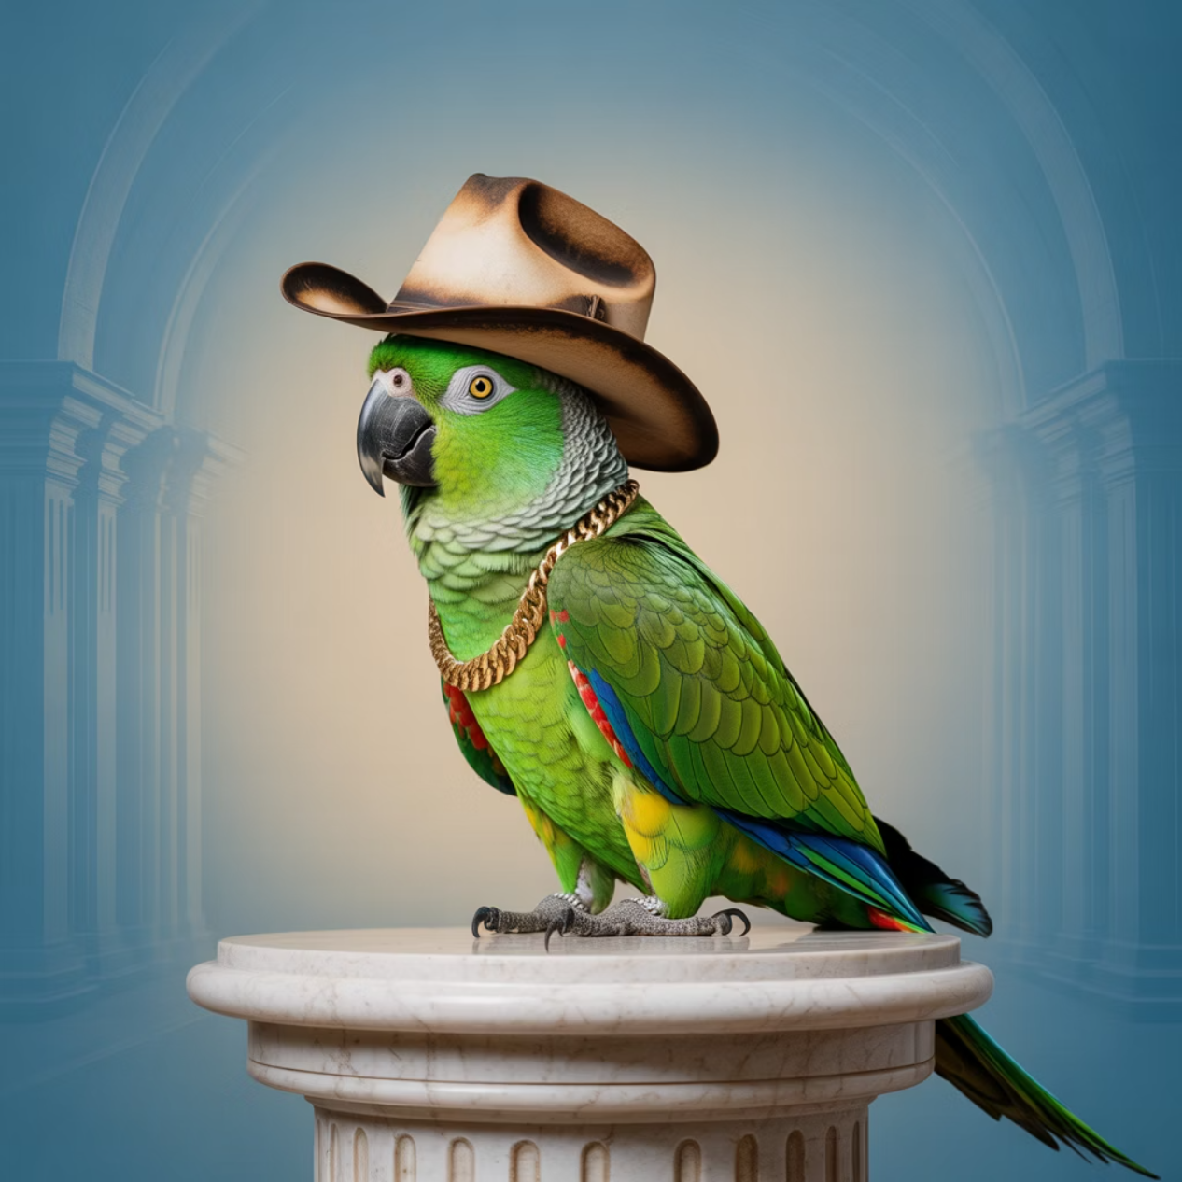


Roles & mental model (builder-friendly)
LangGraph = runtime/orchestrator
State graphs, checkpoints (threads), HITL (interrupt), streaming, time travel
LangChain = getting started & patterns
The agent interface + standard content blocks
Key relationship
The LangChain agent runs on LangGraph → 10-line start, production-grade runtime

Slide 16
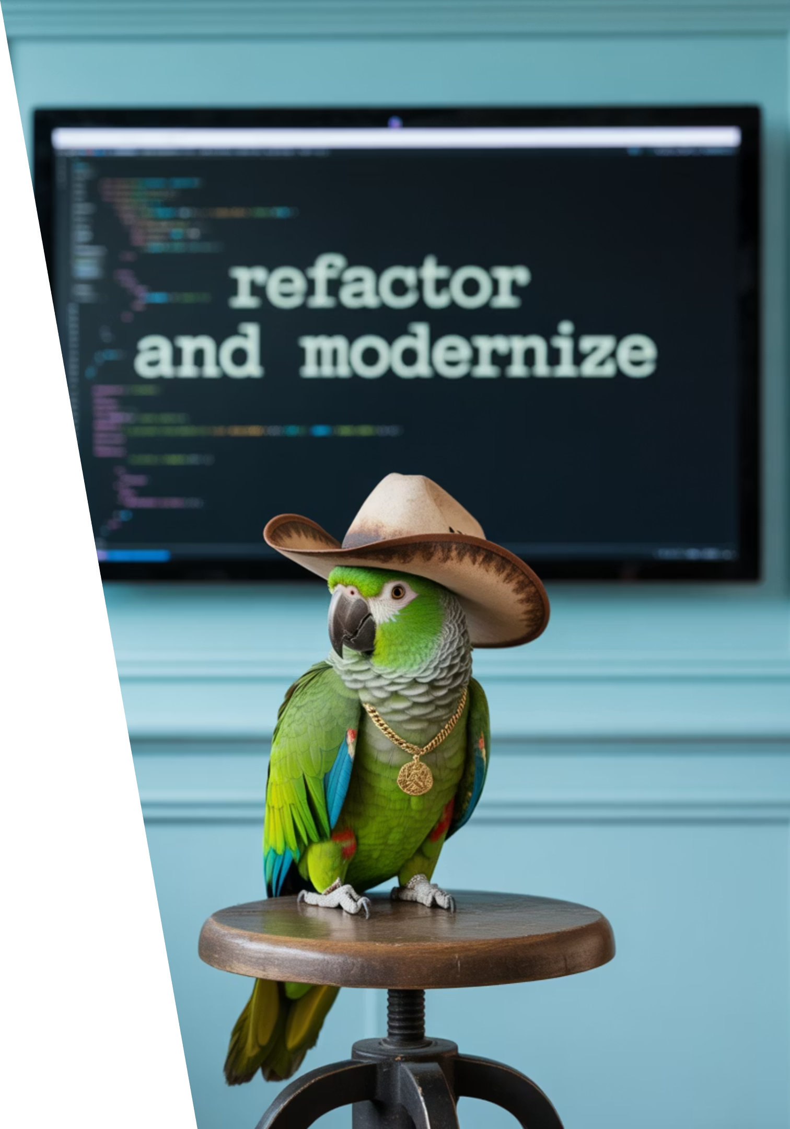
LangChain 1.0α: what actually changed
One agent abstraction
create_agent/createAgent (ReAct-style loop) now on LangGraph
Standard content
.content_blocks / contentBlocks unify reasoning, citations, tool calls, multimodal; backwards-compatible
Slimmer surface + compatibility
Legacy chains/agents move to langchain-legacy
Retrievers are under discussion; the package is significantly slimmed down with a focus on agents. This emphasizes fewer choices, better defaults, and a clear migration path.

Slide 17
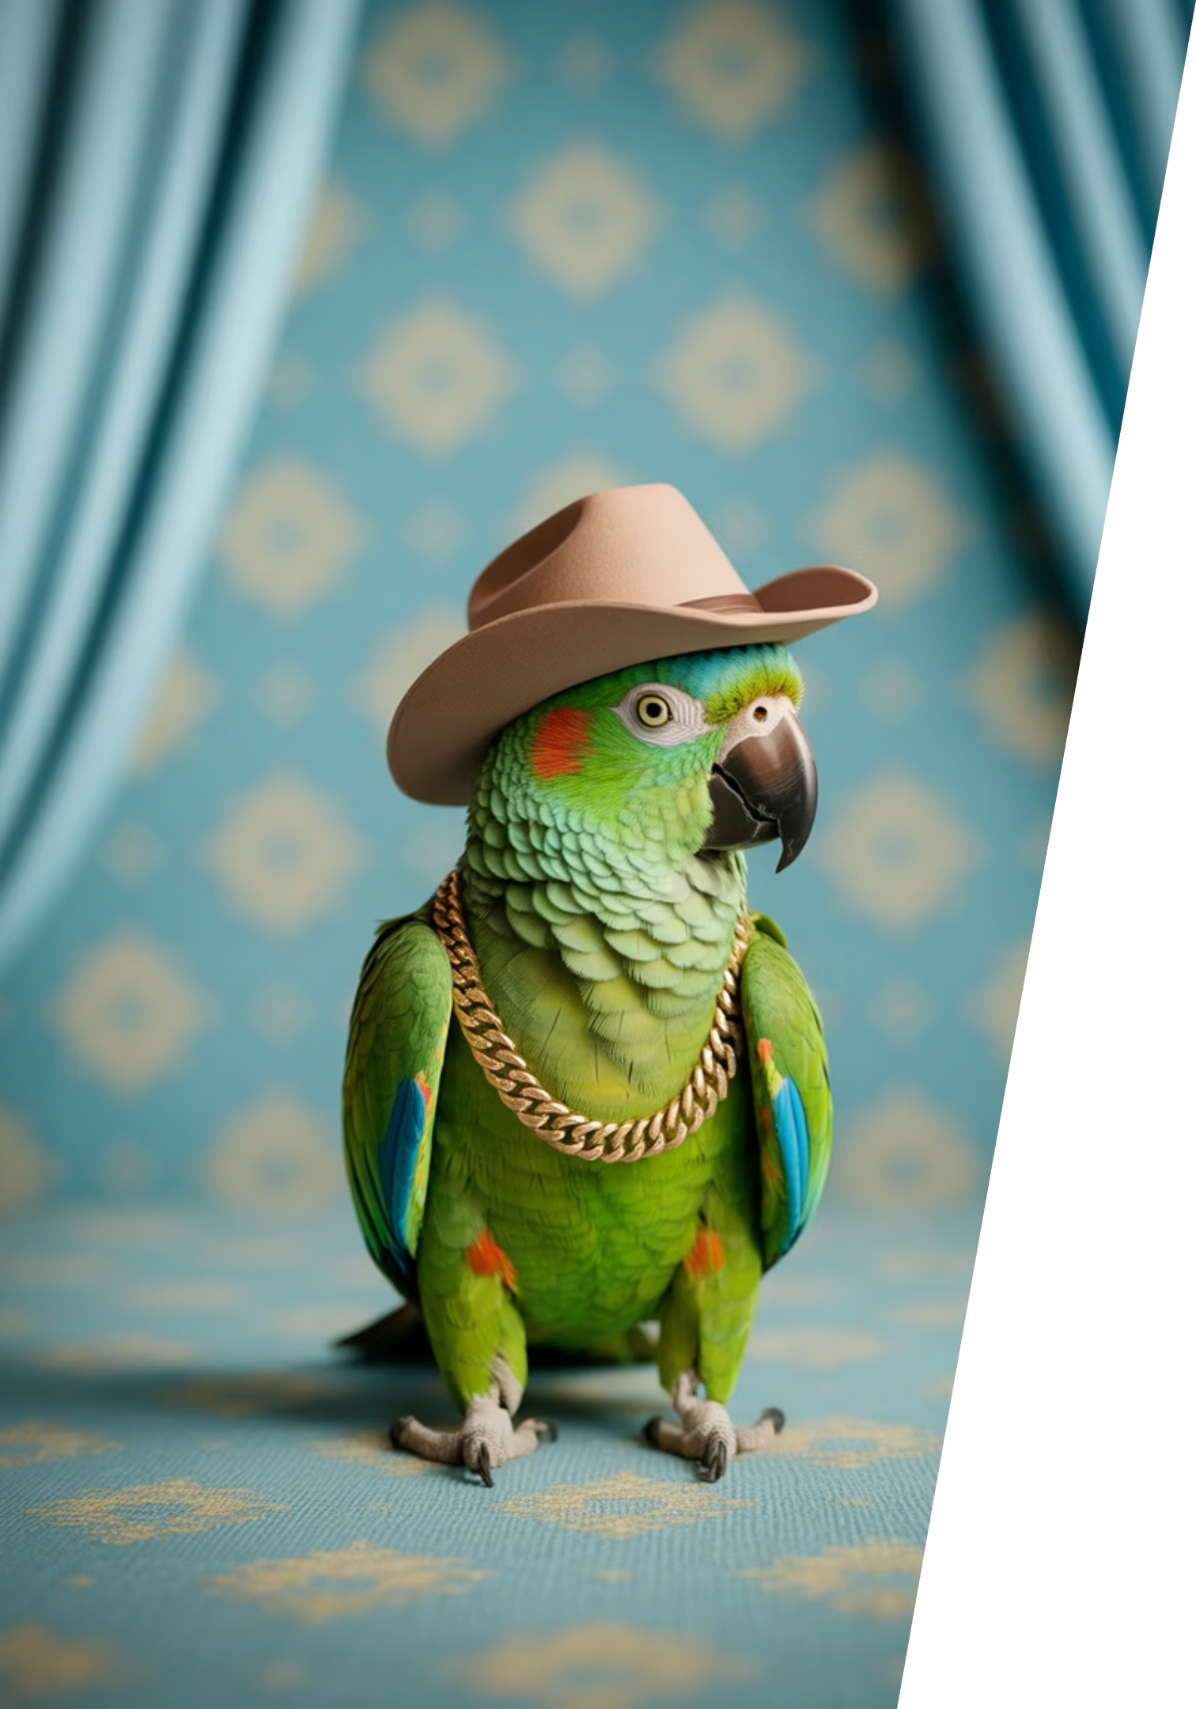
LangGraph 1.0α: what actually changed
01
Conservative v1
Mostly deprecation cleanup; core runtime unchanged
02
Runtime guarantees
Deterministic concurrency (Pregel/BSP), loops, parallelism
03
Built-in capabilities
HITL via interrupt, checkpointing/threads, streaming modes, time travel
Why this matters: stability + observability + control. The conservative approach ensures production systems can upgrade confidently.

Slide 18




Streaming modes (design your UX)
messages
updates
Token stream + model metadata (great for chat feel)
State deltas (progress/events for dashboards)
values
custom / debug
Full state snapshots (visualize evolution)
Arbitrary signals / traces when you need them
Pick the mode(s) that reduce perceived latency and increase user trust in your agentic systems.

Slide 19
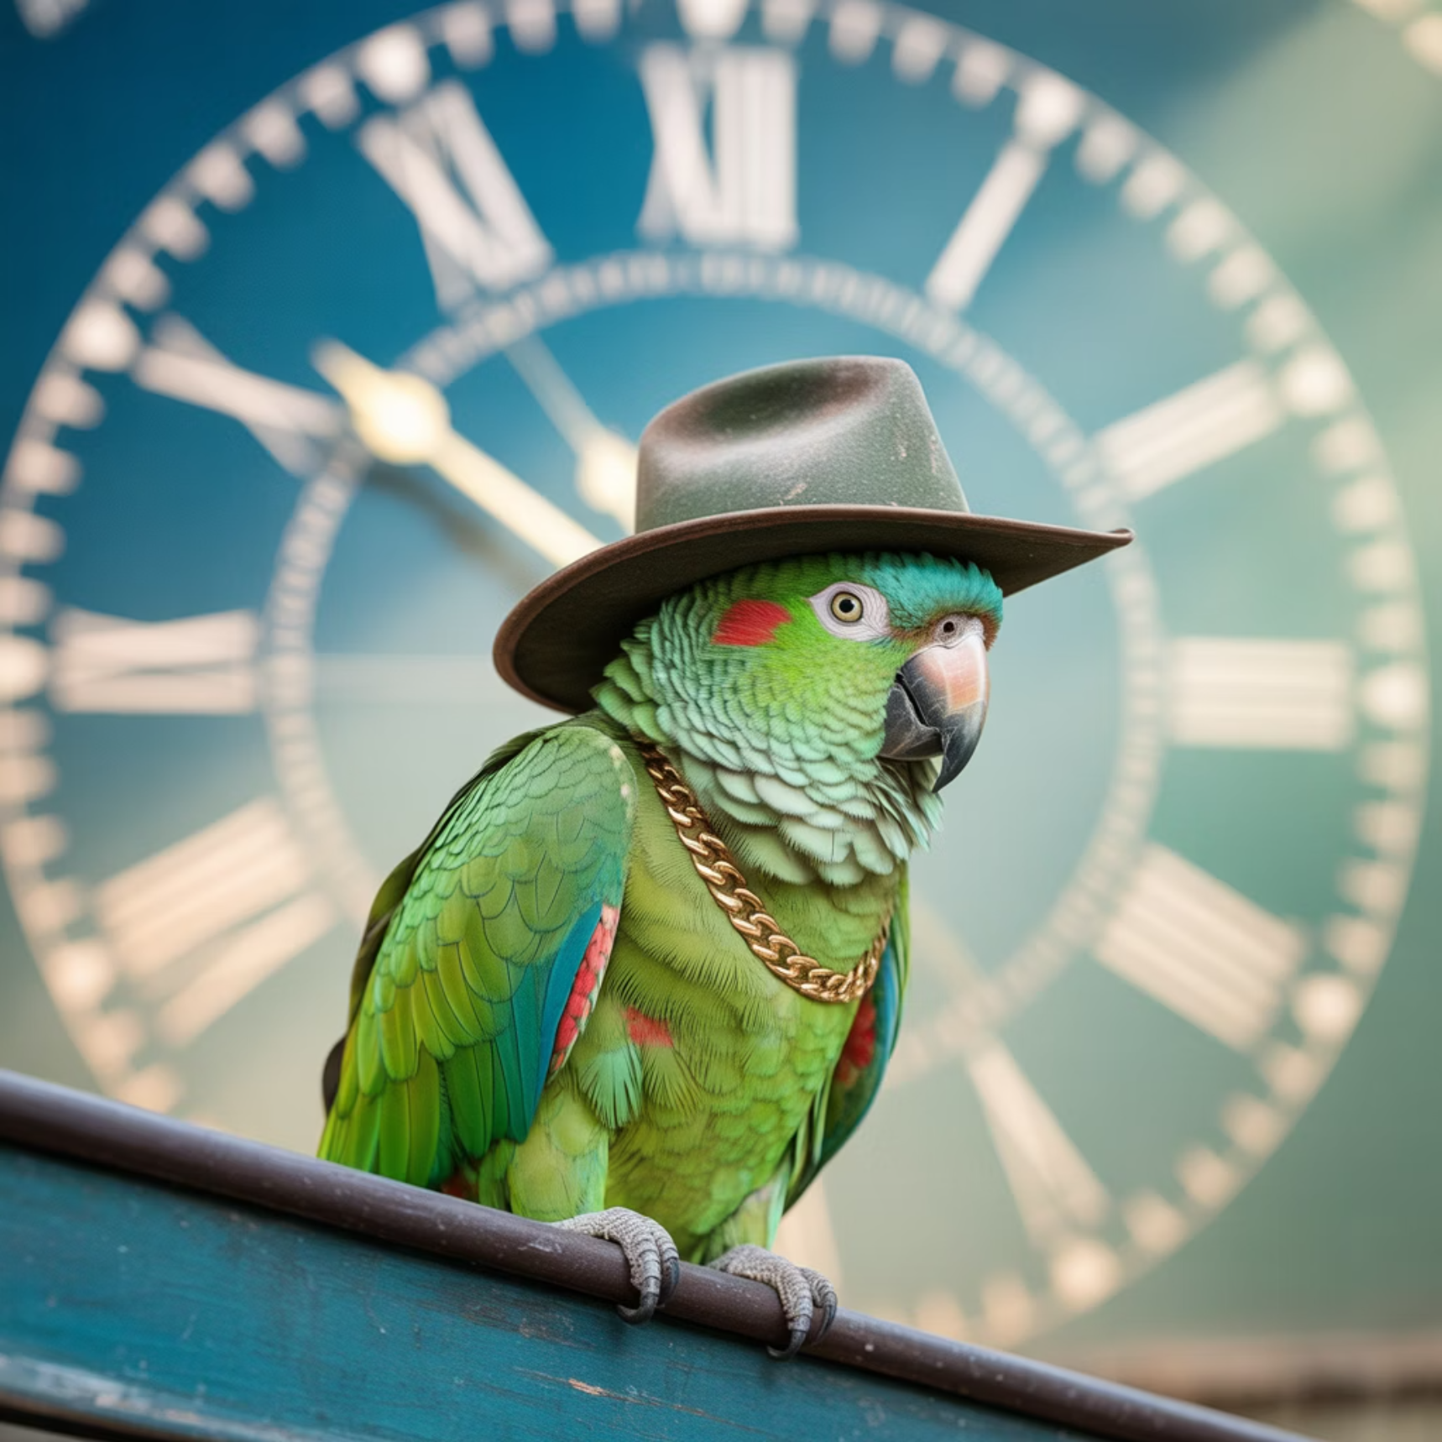

Persistence & time travel (what builders must plan)
Checkpointers
1
Write a checkpoint each super-step into a thread → resume, branch, audit
2
Server defaults
Local disk in langgraph dev; Postgres in langgraph up and deployments
Time travel
3
Resume from any prior checkpoint; replay or modify state to explore alternatives
Treat threads/checkpoints like your production safety net and memory backbone.

Slide 20








Human-in-the-loop (HITL) patterns
interrupt()
Before external side-effects
Pauses indefinitely (state persisted)
Critical approval checkpoint
Resume
After tool proposals
After approval/edit/routing
Review before execution
HITL + checkpoints lets you add enterprise controls without brittle hacks. Design approval gates for policy gates and high-risk actions.

Slide 21
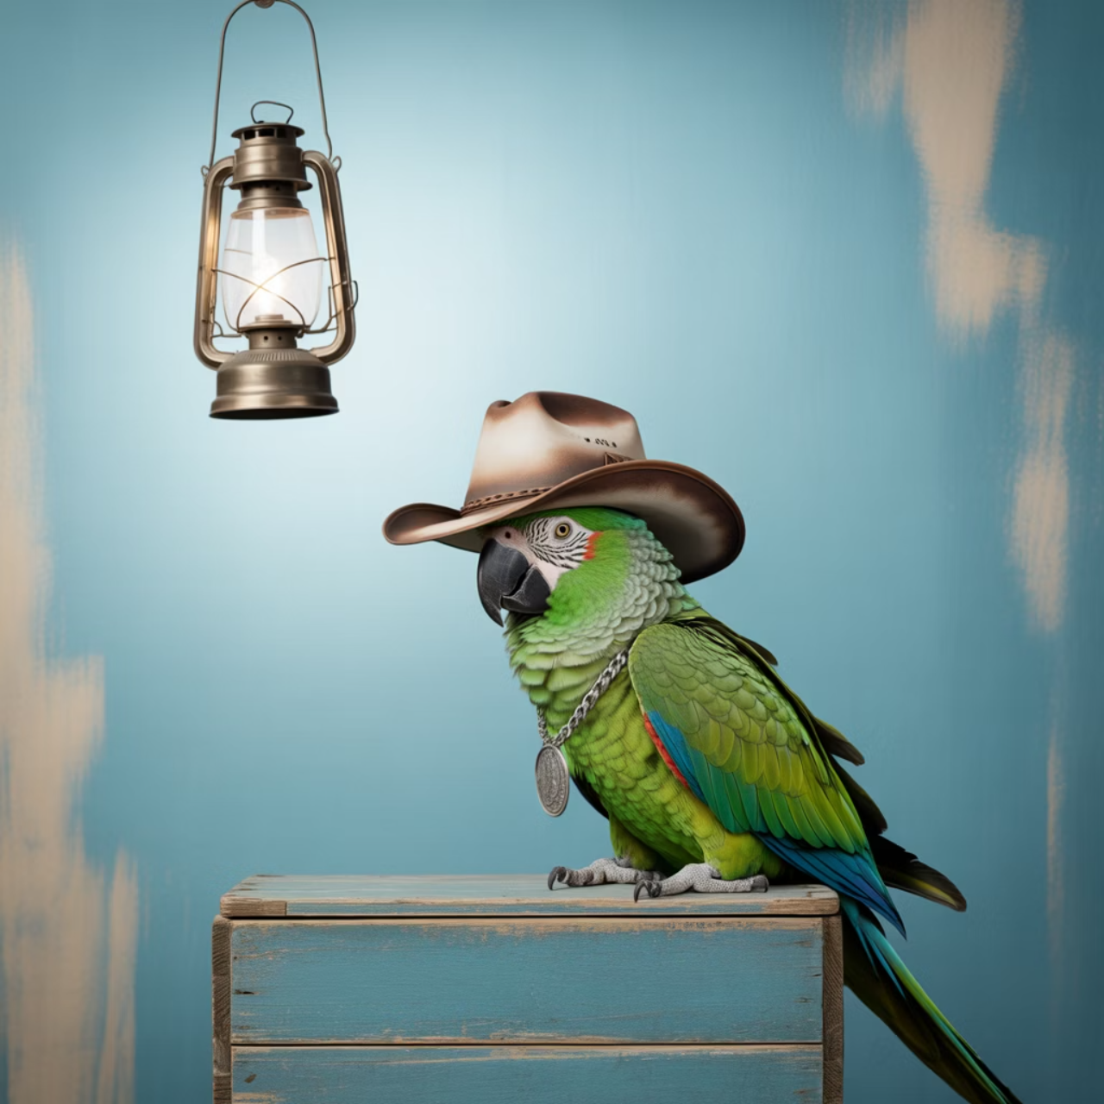
Standard content blocks (why they matter)
1
One typed view across providers
OpenAI, Anthropic, Responses API, etc.; normalizes reasoning, citations, tools, multimodal
2
Zero breakage
Computed lazily from existing .content
3
Practical win
Fewer provider branches, consistent UIs, easier model swaps
"This removes half the glue code when you change models."

Slide 22

Migration & compatibility quick hits
3.10
20
Python minimum
Node minimum
3.9 dropped in v1
Several legacy subpath exports removed
Pin alpha versions; read the Python/JS v1 release notes before upgrading
Legacy path: langchain-legacy keeps older chains/agents working as you adopt v1. Use createAgent and ToolNode for new JavaScript projects.

Slide 23


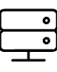


What to build (concept checklists)
Default path
Runtime design
Start with the LangChain agent (it already rides LangGraph)
Choose streaming mode(s), define thread ids, pick a checkpointer (SQLite/PG/Redis) per environment
HITL
Content
Mark interrupt points before risky effects; design resume UX
Adopt content blocks in your renderers/logging
Concrete, immediate steps your team can do tonight—no live coding needed.

Slide 24
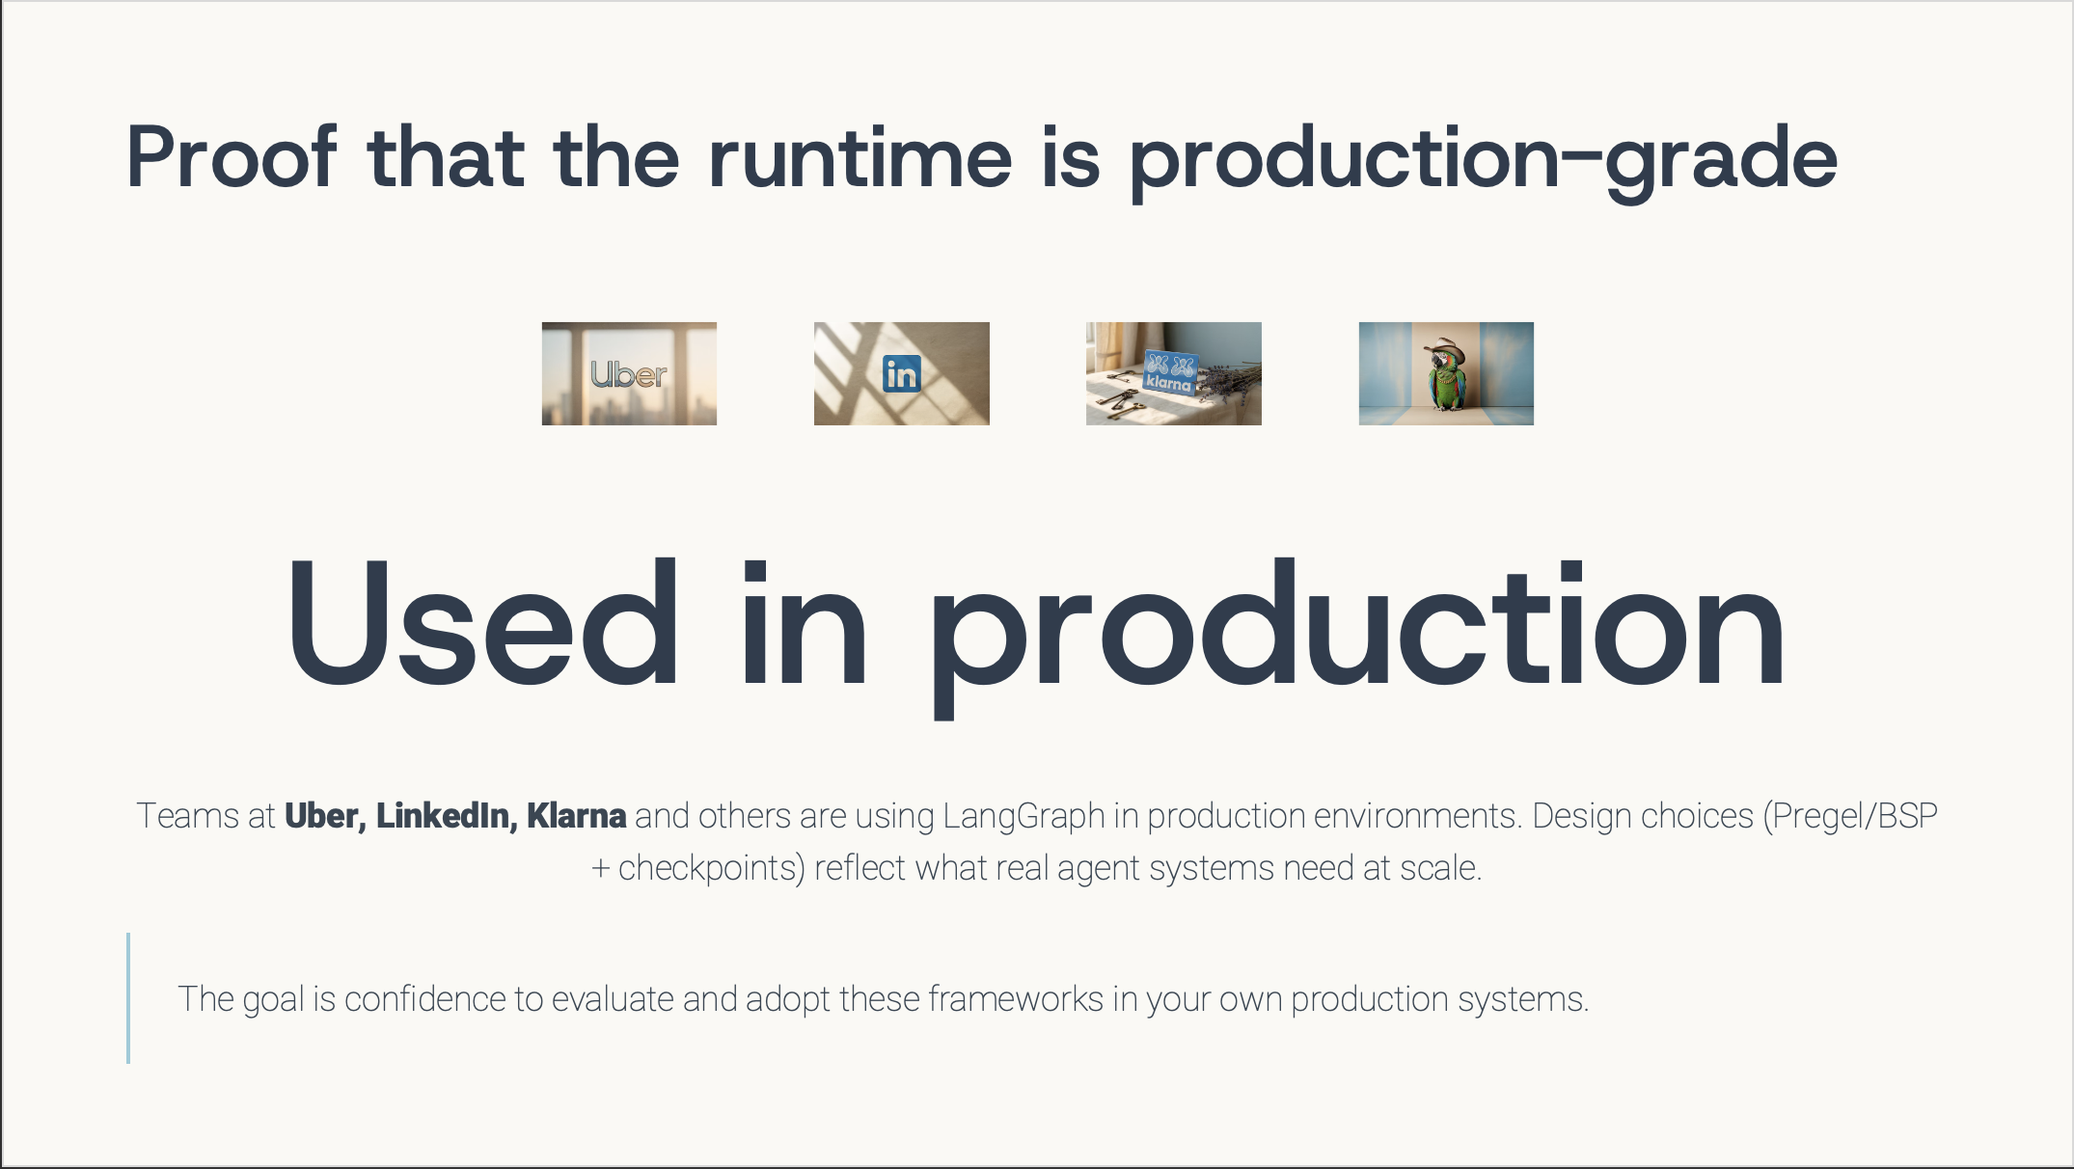


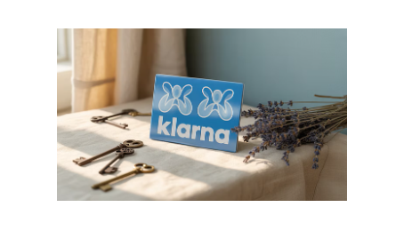
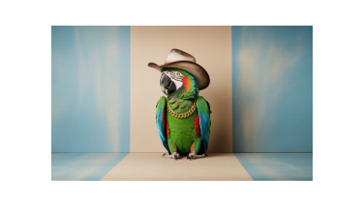
Proof that the runtime is production-grade
Used in production
Teams at Uber, LinkedIn, Klarna and others are using LangGraph in production environments. Design choices (Pregel/BSP + checkpoints) reflect what real agent systems need at scale.
The goal is confidence to evaluate and adopt these frameworks in your own production systems.

Slide 25




Anti-patterns to avoid
Single function agents
Token-only streaming
No structure → no checkpoints/HITL. Prefer graphs
Users need progress → add updates mode
Ephemeral memory
Provider-specific parsing
In prod → add real checkpointer + threads
Hard-coded → use content blocks
These are the most common "gotchas" we see in code reviews. Avoid these patterns to build more maintainable agentic systems.

Slide 26
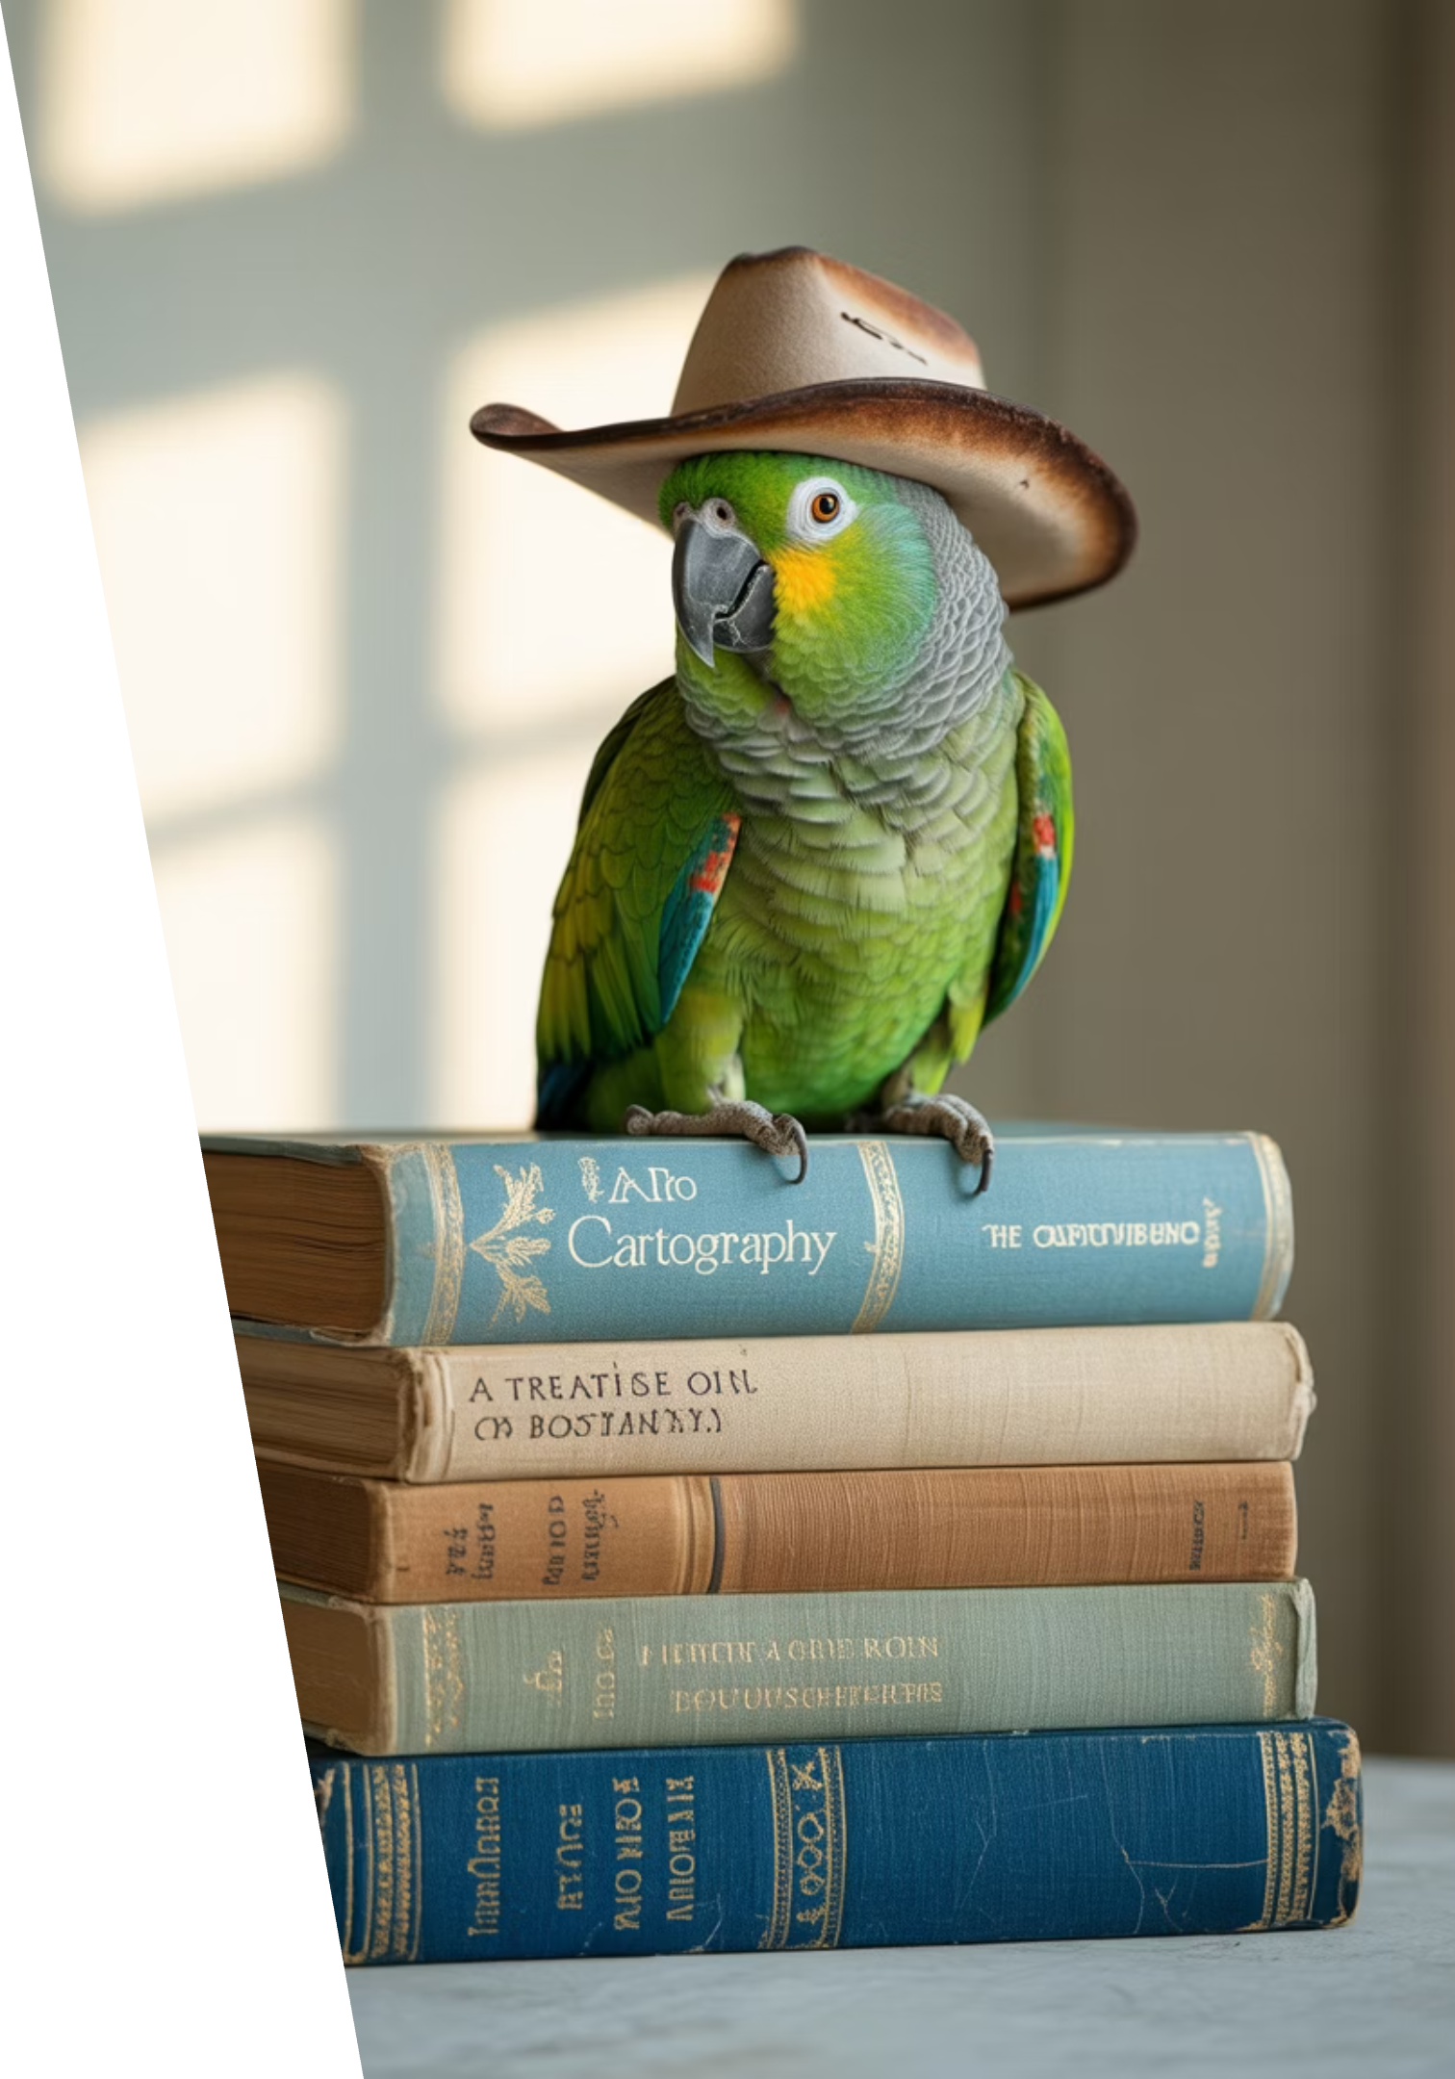


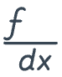

Docs & learning path (what's improved)
Unified OSS docs site
Python & JS together for streamlined learning
Dedicated guides
Streaming, persistence, HITL, time travel
Integration docs prioritized
Contrib guide and YouTube series organization
Notebook → enterprise templates
Production-ready patterns and examples
.

Slide 27
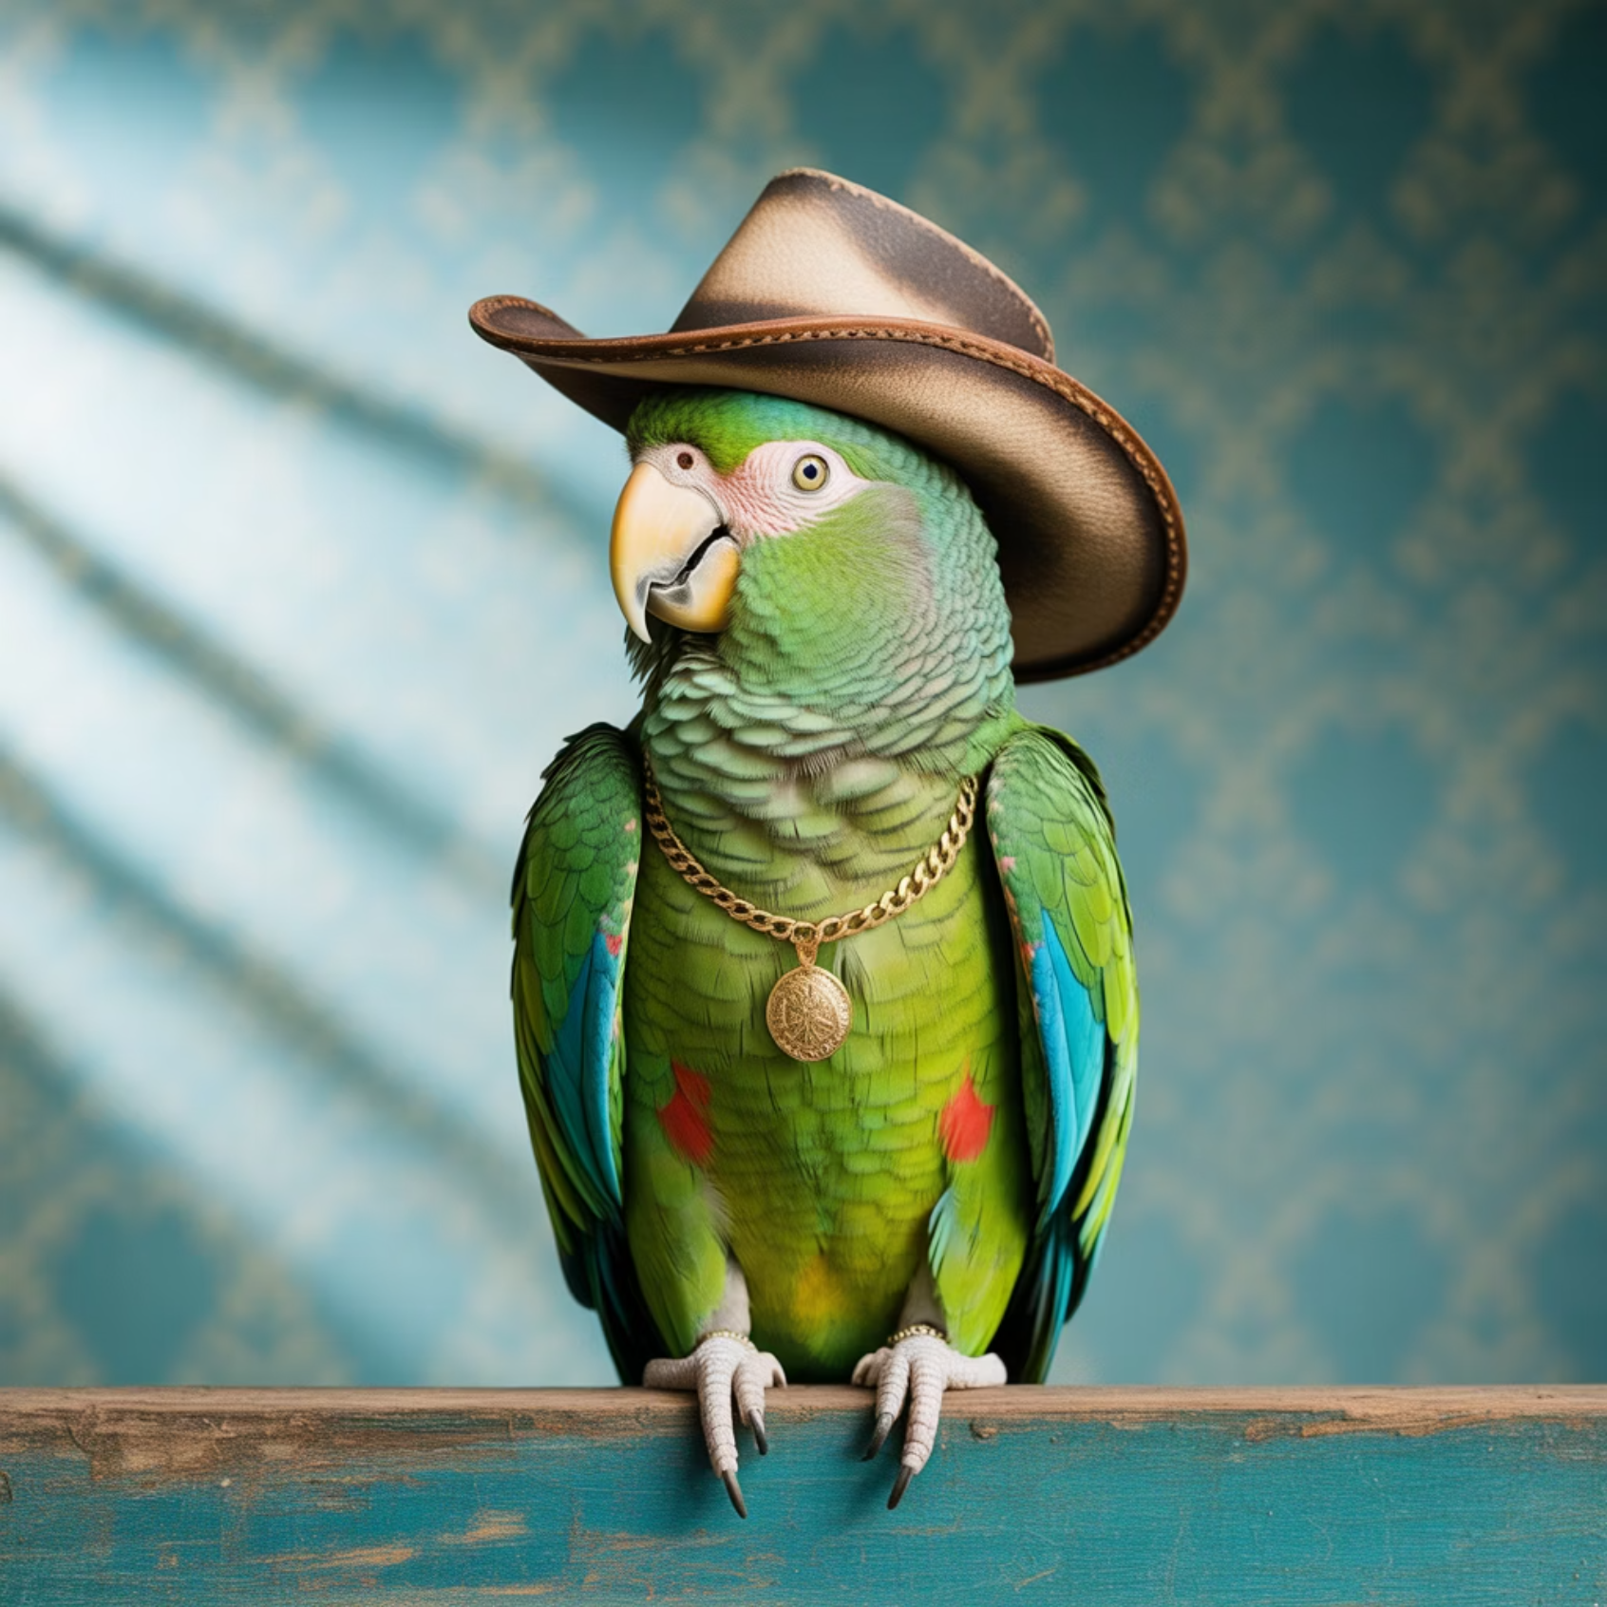


Platform & naming (WIP / directional)
Naming consolidation
Considering consolidating commercial offerings under "LangSmith platform" (vs "LangChain Platform") to reduce naming confusion
User insights
~20% of LangSmith users don't use LangChain
Takeaway for builders: expect clearer hierarchy visuals; watch for updates in the coming weeks
Mark explicitly as directional, not GA.

Slide 28









Insights & analytics (forward-looking)
Usage patterns
Failure modes
New Insights clusters common behaviors
Identify and analyze system failures
Future monitoring
Drill-downs
Hooks for advanced observability
Deep investigation capabilities
Currently in beta behind a feature flag
Useful for observing agent behavior across threads and checkpoints in production environments.

Slide 29
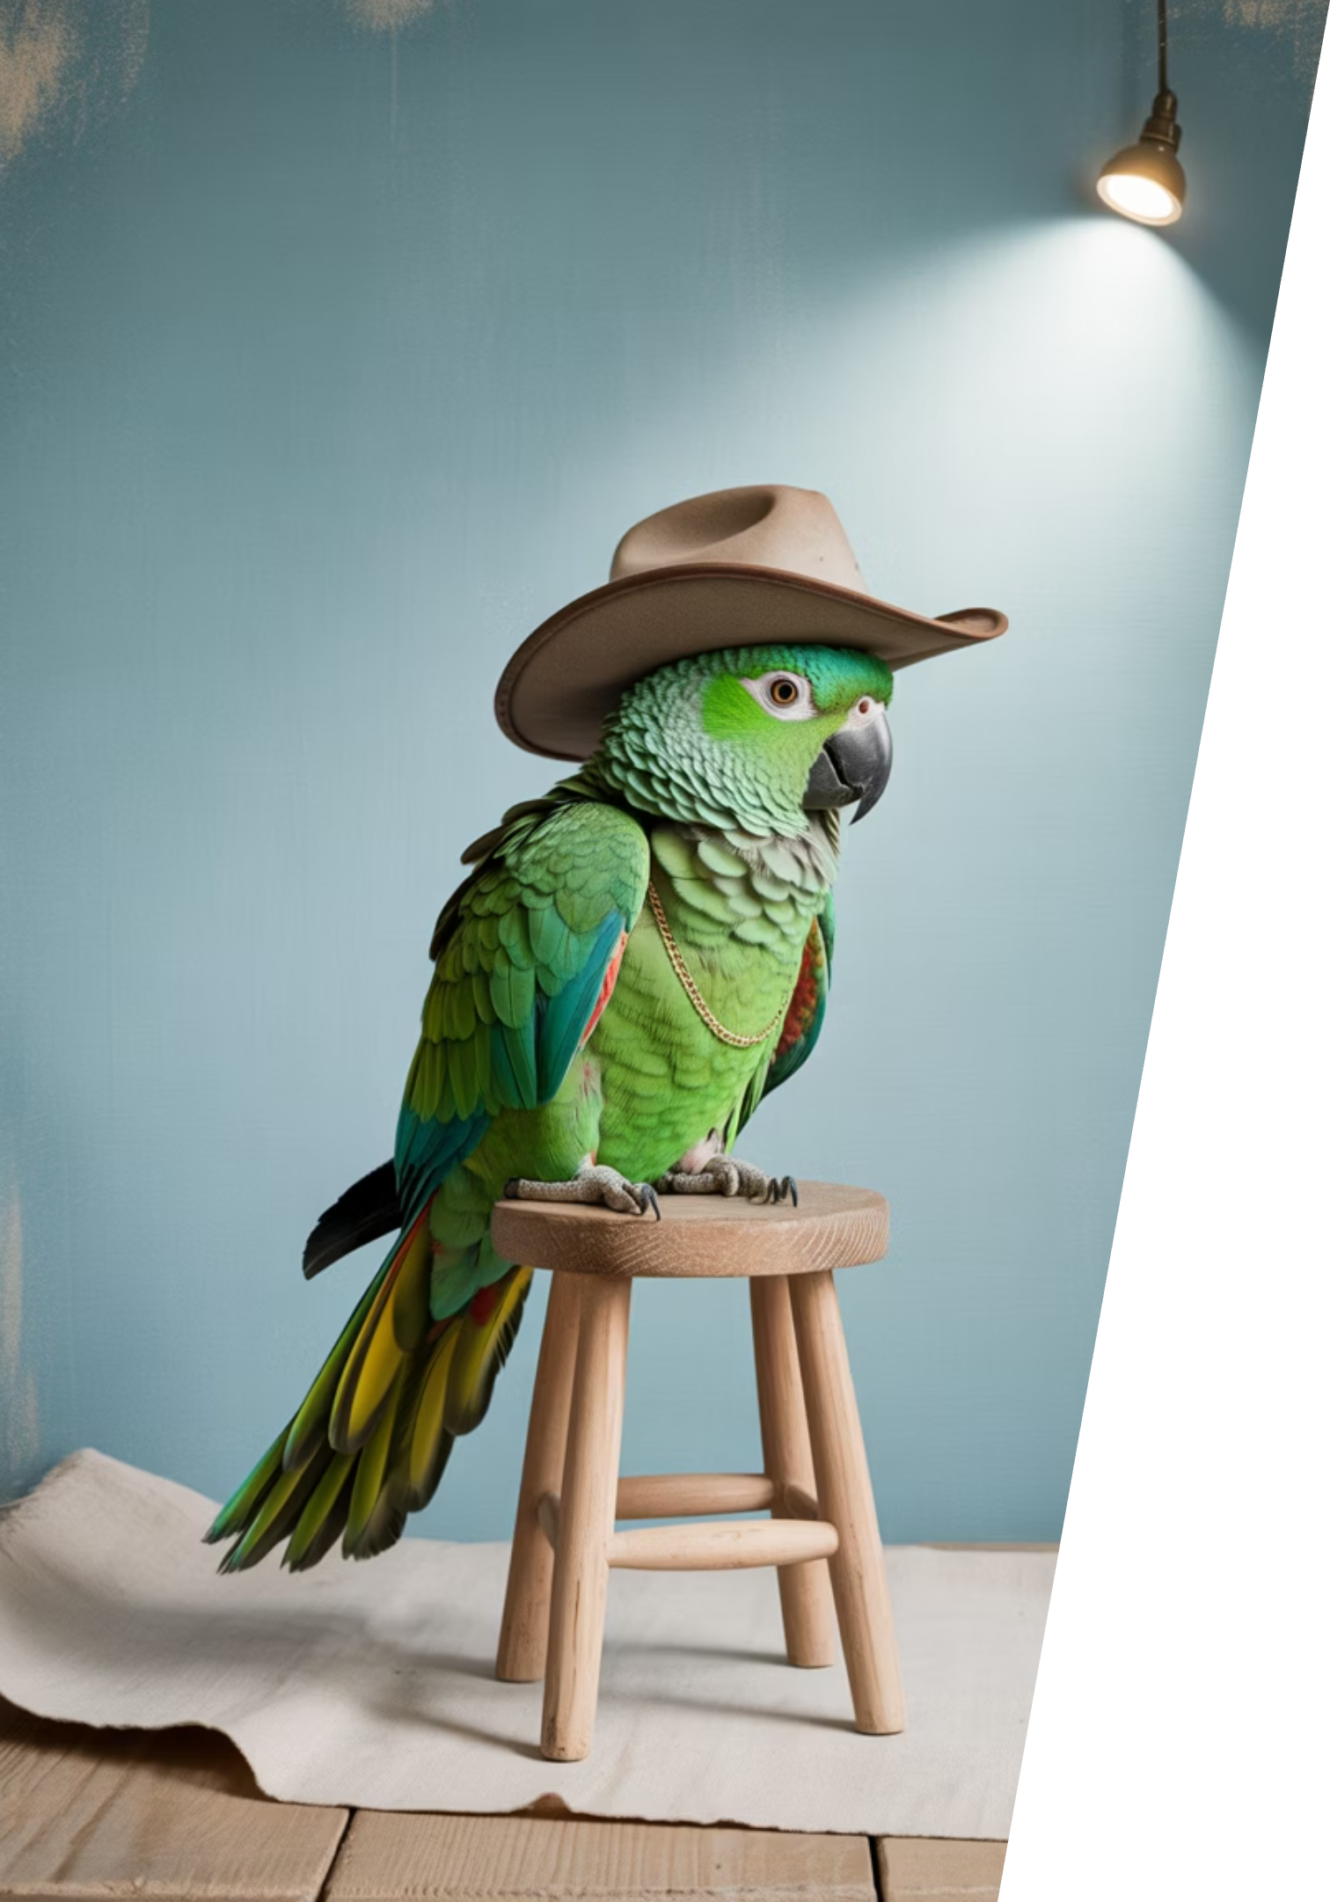
One-page takeaway (printable slide)
Start simple
Start with LangChain's single agent; drop down to LangGraph when you need custom control
Design for production
Design for streaming, checkpoints, HITL, time travel from day one
Adopt standards
Adopt content blocks to de-risk provider swaps
Mind the floors
Python ≥3.10, Node ≥20; use langchain-legacy as needed
This is the "clip and share" summary for the AI MUG community.

Slide 30
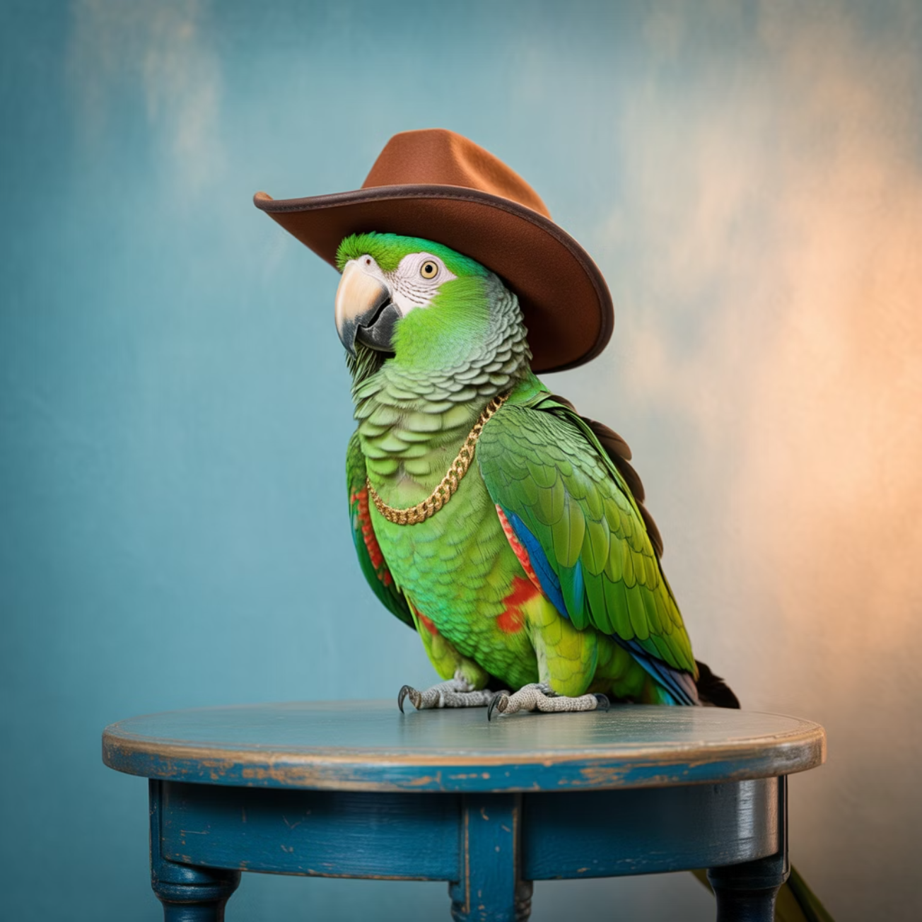
Q&A
Where to follow changes:
Python v1 release notes
JS v1 release notes
Alpha announcement blog
Standard content blog
Questions welcome on:
Migration strategies
Streaming/HITL design patterns
Content blocks implementation
Production deployment considerations
Ready for your questions!

Slide 31
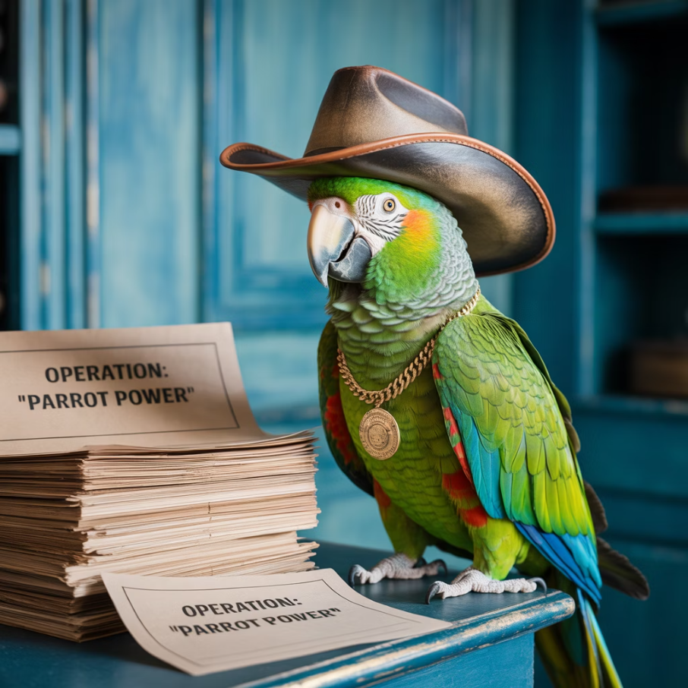
References
Key Resources:
Alpha announcement & timeline (late Oct target; agent built on LangGraph; legacy pkg; unified docs)
LangGraph design (Pregel/BSP)
Streaming modes (values/updates/messages/custom/debug)
HITL / interrupt
Persistence/threads & time travel
Content blocks explainer
JS v1 notes (Node ≥20, createAgent, ToolNode)
Python v1 notes (Python ≥3.10, legacy, .content_blocks)
Production usage (Uber, LinkedIn, Klarna)

Slide 32
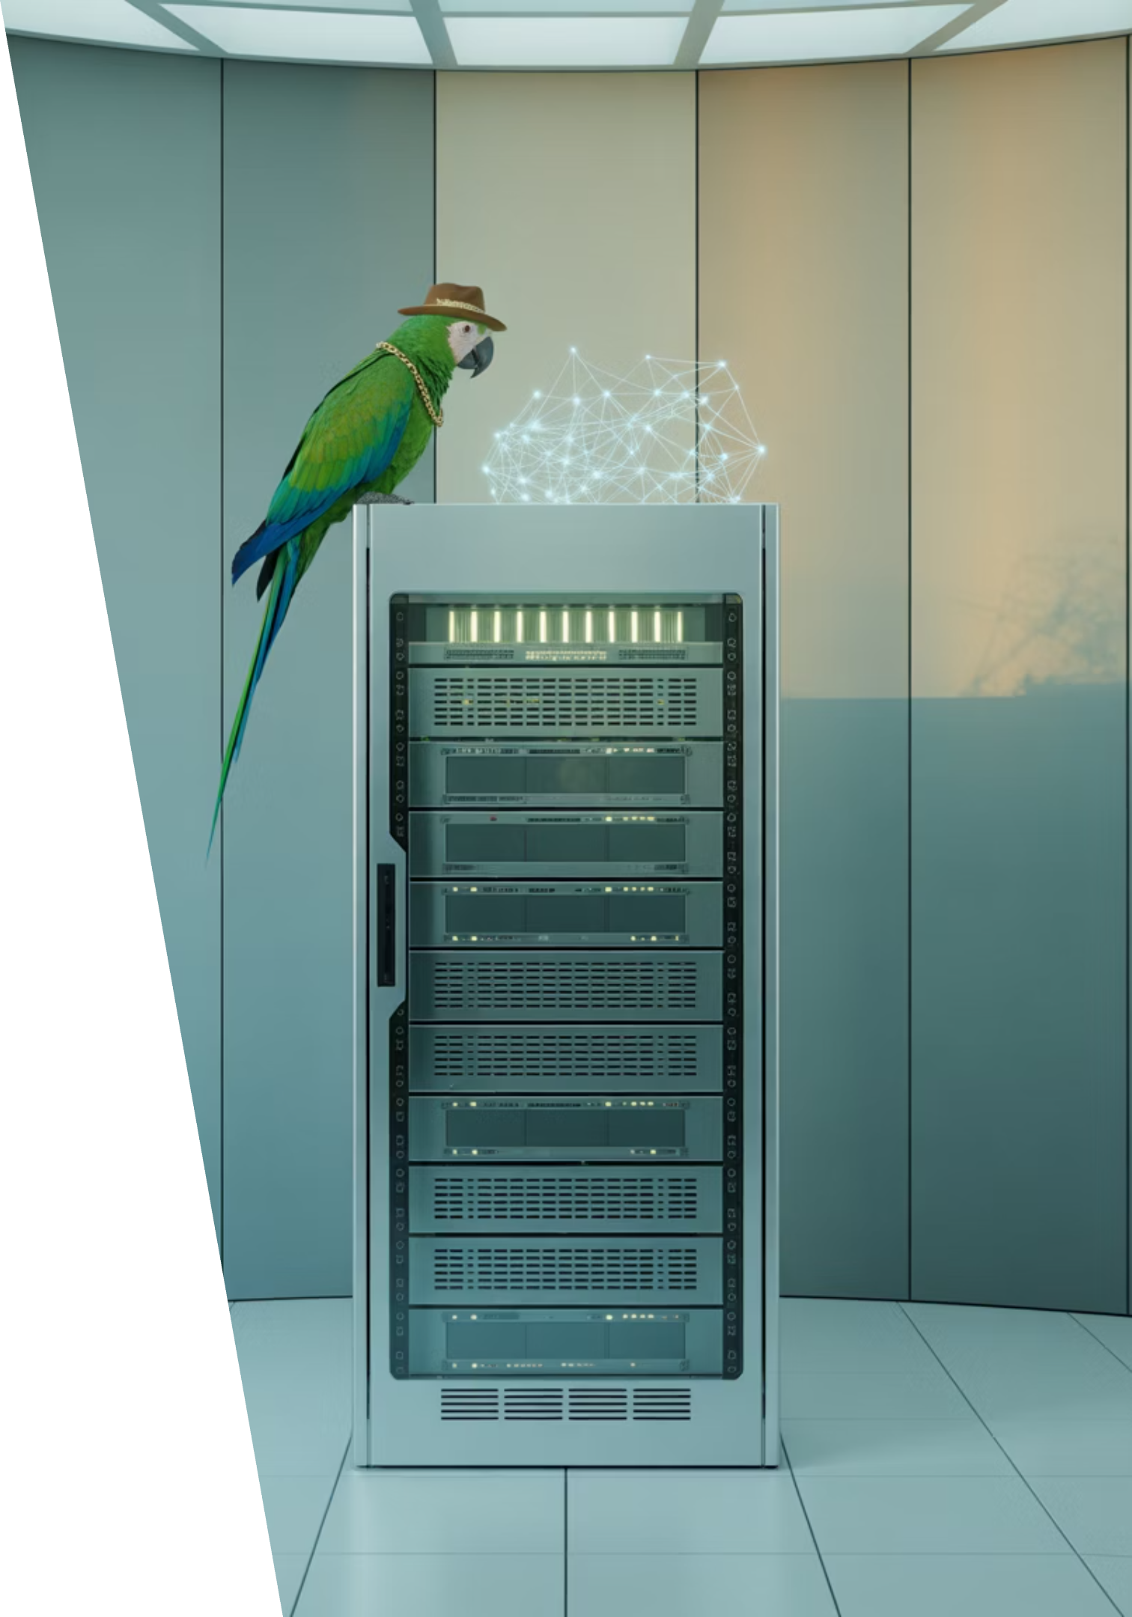
Presented by Sal Castoro
Claude Code & Custom Agents
Building intelligent systems requires seamless orchestration between backend logic and dynamic AI capabilities. Let's dive into how Claude Code empowers custom agents and their subagents to deliver robust, scalable solutions.

Slide 33
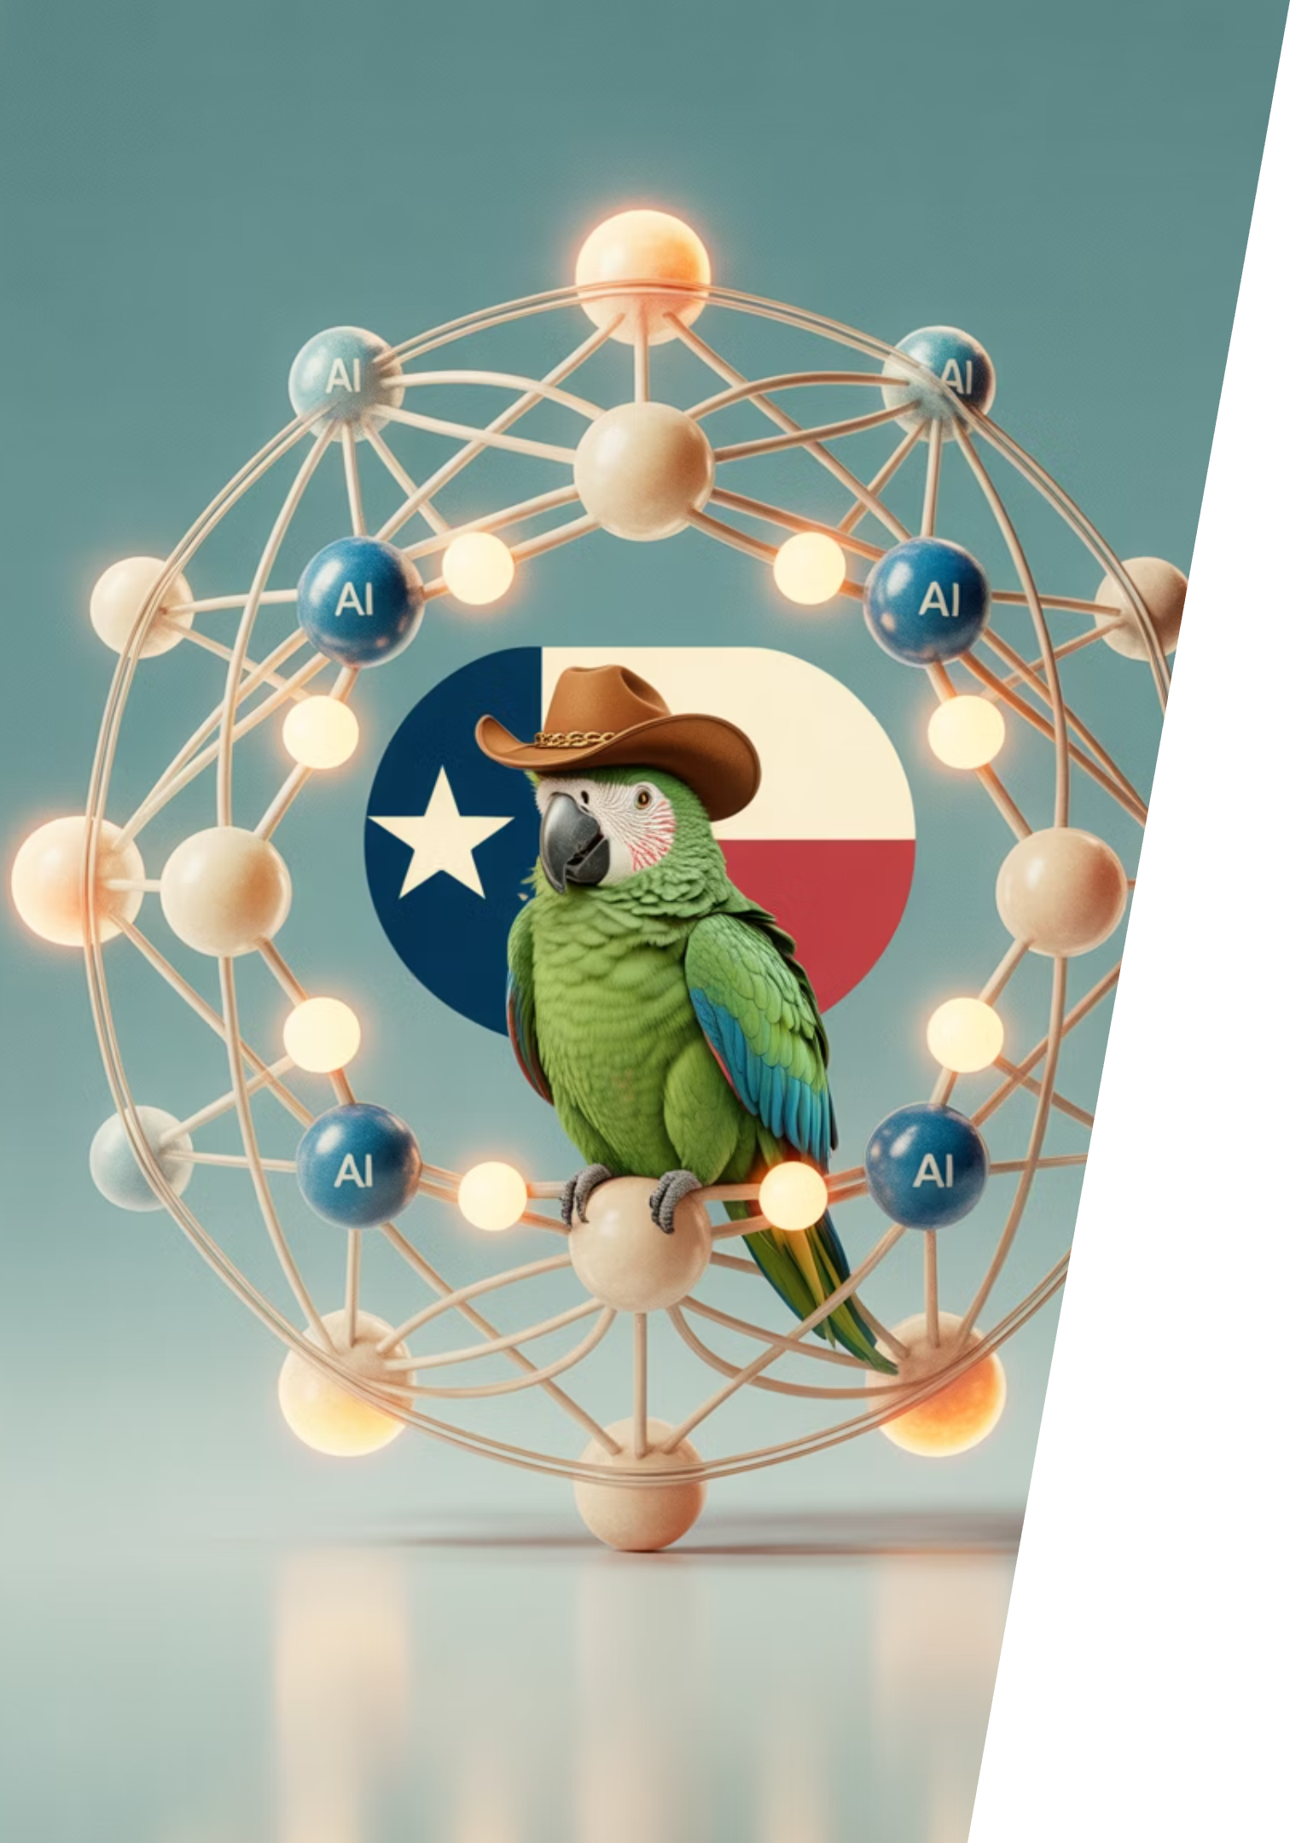
Presented by Collier King
Deep Agents: Practical Insights
Collier will share how deep learning is making AI agents smarter and more capable, allowing them to go beyond simple tasks and tackle complex problems with adaptive behavior.

Slide 34
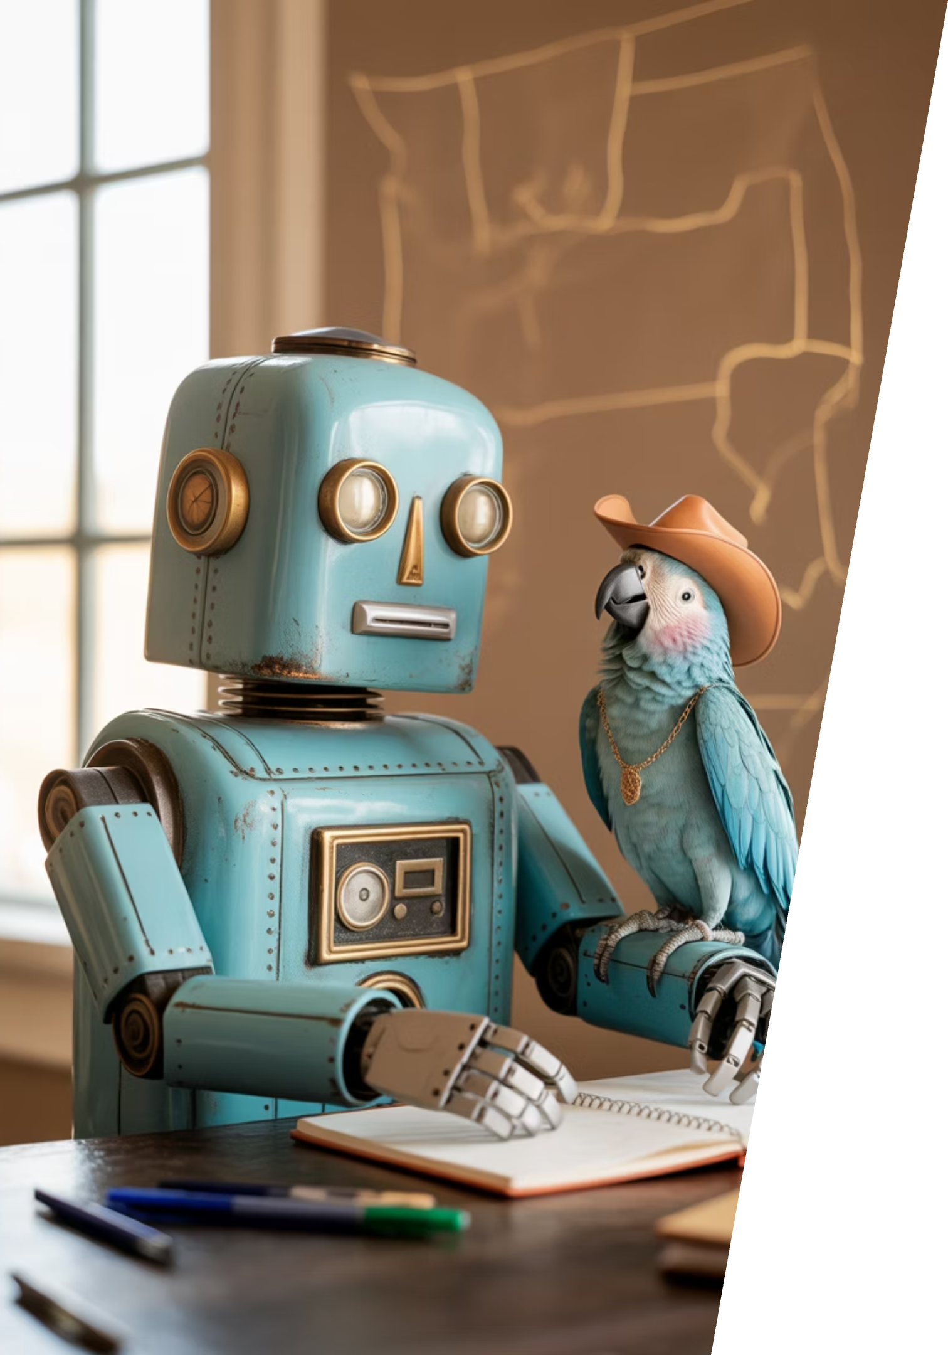
Presented by James
Rosie the Robot: Desktop Cleanup Demo!
Join James for a live demonstration of "Rosie the Robot"—a practical AI application designed for efficient desktop automation and digital workspace organization.

Slide 35
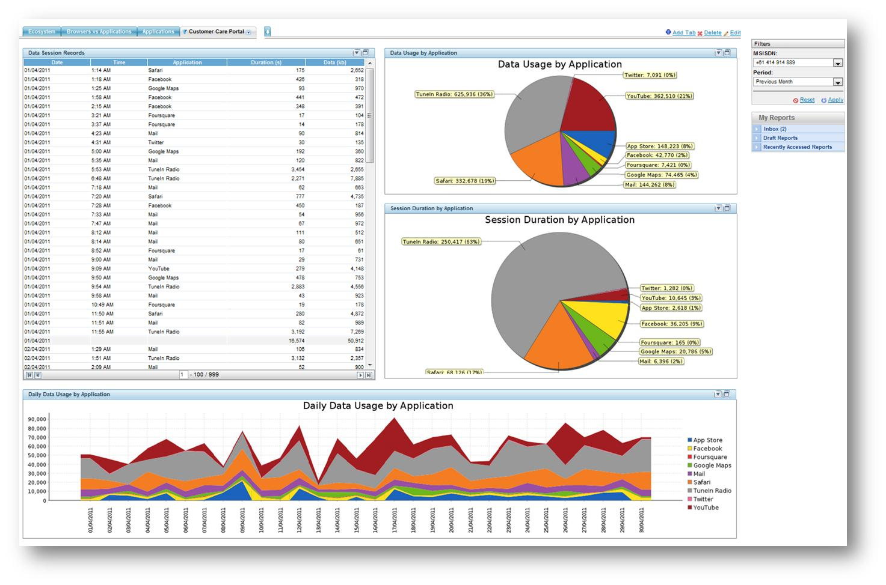
Presented by Jeff Linwood
Streamlit Dashboard:
Join Jeff for a quick intro to streamlit as a dashboard, with a quick intro of how to integrate LangChain into it.
This Photo by Unknown Author is licensed under CC BY-SA

Slide 36

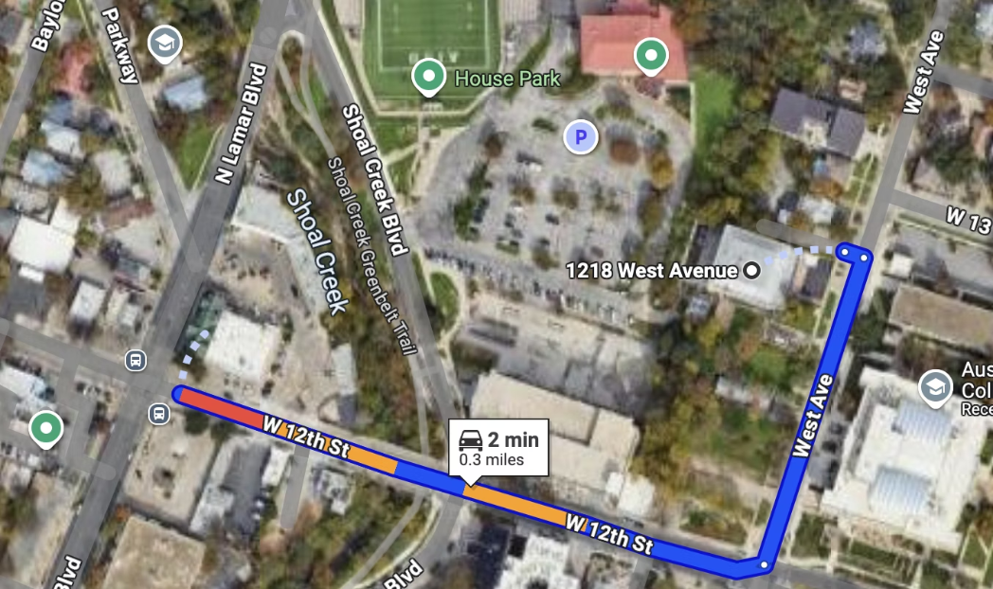





RGC-3000 and Tavern After Party
Join us after the meeting to continue conversations, network, and enjoy some Texas hospitality at The Tavern! Our green parrot mascot might even make an appearance.
Website
aimug.org – All things LangChain and AIMUG
Discord
Join us for ongoing conversations
GitHub
ACC RGC3000 & The Tavern
Austin LangChain Repo – Check out our projects
ACC Main Campus
Meetup
Austin LangChain Group
Twitter
@AustinLangChain – Latest updates
YouTube
Austin LangChain Channel

Slide 37
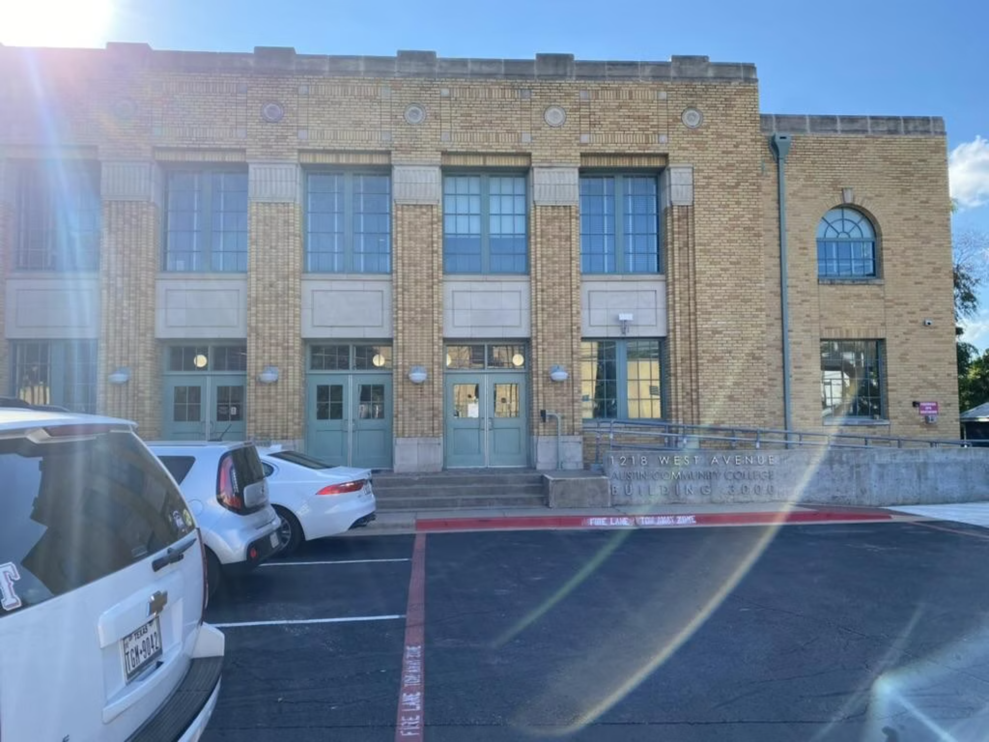
Finding US - ACC RGC-3000
The Austin Community College Rio Grande Campus (RGC) Building 3000 is our regular meeting location, offering modern facilities perfect for our tech-focused gatherings.
Easy Access
Centrally located in downtown Austin with parking available nearby
Tech-Ready Facilities
State-of-the-art presentation equipment and reliable Wi-Fi
Collaborative Spaces
Room arrangements perfect for both presentations and hands-on workshops
Look for Tex, our green parrot mascot with his cowboy hat and gold chain, greeting you at the entrance!

Slide 38






Next Event – October 1 ACC RGC3000
Wednesday, August 27th
Casual Networking
Bring Your Projects
Join fellow AI enthusiasts for coffee, conversation, and coding in a relaxed Austin atmosphere
Get feedback, troubleshoot, or collaborate on your latest LangChain experiments
All Welcome
From beginners to experts, our community embraces diverse perspectives and experience levels
"Be cool to each other, don't be gross." Our only rule reflects our commitment to Texas hospitality in the tech world.
Keep an eye out for Tex, our green parrot mascot with his cowboy hat and gold chain – he'll be there too!

